Slide 1
Learning in the Innovation State
March 2015

Slide 2
A Ten-Year Look at Student Performance
Percent of Students Proficient and Advanced by Subject, 2004 through 2014

Slide 3
Keep Up Growth Data over 10 Years
Percent of Students Making Keep-Up Growth by Subject, 2004 through 2014

Slide 4
Catch-Up Growth Data over 10 Years
Percent of Students Making Catch-Up Growth by Subject, 2004 through 2014

Slide 5
Landscape Continued…
Between 2010 and 2020, new jobs in Colorado requiring a postsecondary education and training will grow by 716,000, while jobs for high school graduates will grow by 268,000 or nearly 3x the rate of growth.
Colorado ranks 3rd in terms of the proportion of its 2020 jobs that will require a bachelor’s degree and is 48th in jobs for high school graduates or dropouts
Source: Georgetown University, Job Growth and Education Requirements, 2013

Slide 6
Data Highlights
77.4% On-time graduation rate
2.4% annual dropout rate (10,546 students)
55.2% of high school graduates immediately enroll in 2 or 4 year college
More than one-third of them need remedial coursework
Colorado youth unemployment is on the rise and higher than the national average. 16.7%
26.2% Age 16-19
12.9% Age 20-24

Slide 7
Colorado’s Vision for Next Generation Learning – Student Outcomes
How to Maximize Unique Potential of All Students & Align to 21st Century Needs
Annual attention to increased development of each of the following characteristics: Academic competencies including: math skills, literacy skills, and critical thinking skills Professional competencies including: ability to manage time, collaborate with others, and independently learn new things Entrepreneurial competencies including: the ability to manage professional risk, make interesting connections, and learn from failure Deep knowledge of self (personal competencies) that students can use to make good decisions that play on their strengths Drive to contribute (civic competencies) as a member of the community and the workforce
Notes:
GRETCHEN (2 min) – it is the combination of these things that brought us together around a common vision…
Over the last few years, CLF and CDE have been facilitating a process to establish (co-create?) a statewide vision for next gen learning
Informed by research, employers, parents, educators, and policy-makers, national and, through GELP, international experts and colleagues, we have established this vision of what learning needs to look like to prepare our next generation of learners to live successful, productive, and happy adult lives in the 21st Century.
Students still need academic competencies: those things that reside in the mind…math and literacy skills, robust content knowledge and the ability to use their knowledge and skills to reason, synthesize and analyze – those outcomes we are most familiar with, those that reside in the mind.
Students also need professional competencies: those things that reside in our hands, and represent what we can do with the knowledge and skills. The ability to manage a project, manage time, to work collaboratively and effectively with others.
And in the economy Sam described, students also need to build their entrepreneurial competencies: build their ability to learn capitalize on interesting connections, persist through failure, their ability to manage risk of the more volitile 21st century work environment Those outcomes that live in your gut.
To make good decisions and position themselves, we know that In their heart, students need to know what they are good at, when they need help, what brings them joy. Only with that kind of knowledge will they be able to advocate for themselves getting into those situations that make the best use of their capacity and bring them joy.
And finally – students need a drive to contribute, to get up on their feet and get moving. None of the investment of public education will pay off, if at the end students don’t feel a real desire and responsibility to contribute as neighbors, workers, and community members
If all Colorado students exited our system with this capacity
we would no longer have a paradox in Colorado, we would produce the workforce necessary to support our local industry.
and we would have individual students with strong post secondary options who are ready to be self-directed young adults

Slide 8
Every student leaving our schools as curious as when they arrive…

Slide 9
What are the characteristics of learning environments that help students develop core competencies, self knowledge and the drive to contribute in a way that maximizes their UNIQUE POTENTIAL?
PERSONAL AND PERSONALIZED
COMPETENCY-BASED
CO-CREATED
SAFE AND HEALTHY
TIME-, TALENT-, AND TECHNOLOGY- ENABLED

Slide 10
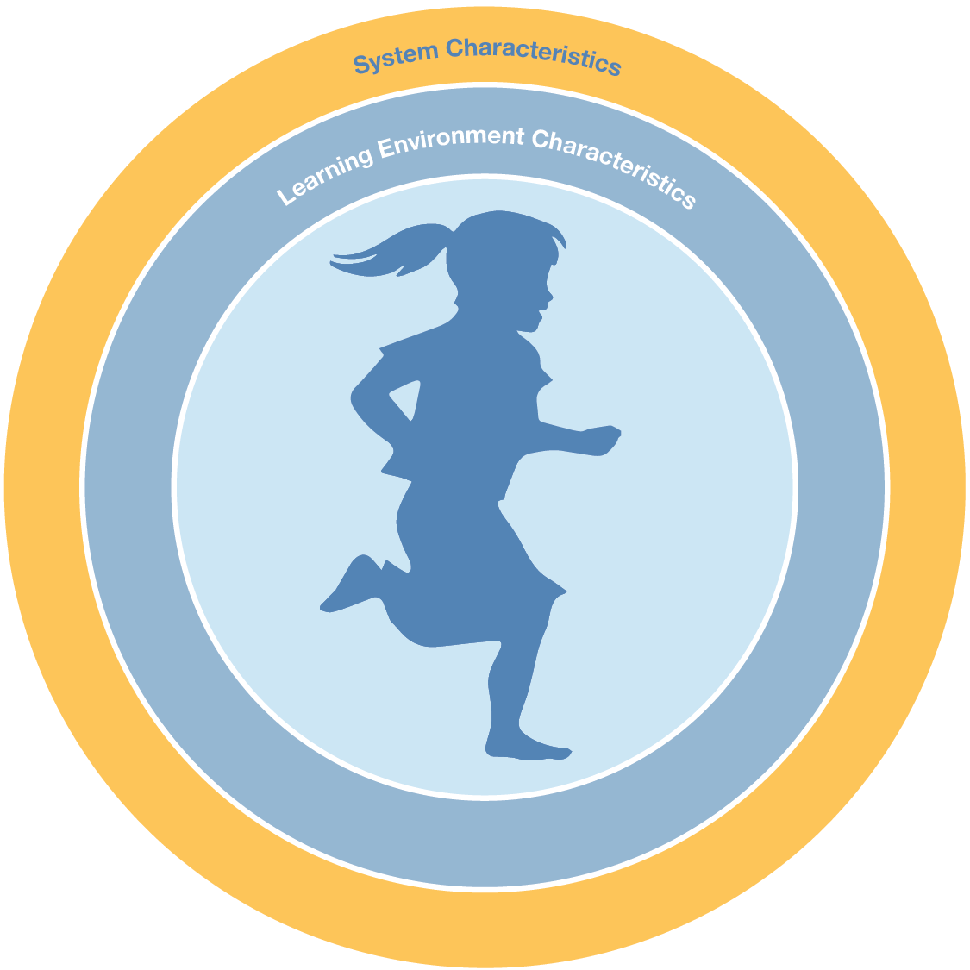
Colorado’s Vision for Next Generation Learning – System Characteristics
Current |  | Next Generation
Risk averse |  | Manages risk through learning agenda
Narrow focus of accountability |  | System incentivizes attention to a balanced set of student outcomes
Centralized decisions |  | Co-created
Students and teachers organized into cohorts |  | Organized to be responsive to individual students
Driven by historical schedules and structures |  | Driven by learner needs

Slide 11
Center for Best Practice
Storytelling
Shifting CDE Practice Based on Lessons from Storytelling
Cross- Divisional Strategic Imperative: Accountability 3.0

Slide 12
Conceptual Model of Accountability 3.0
Commonly identified academic competencies, and sample non-academic competencies
Pilot of one or two student data systems that include an “on track” pacing component, and include locally determined scores per competency in the common performance tasks
Student by Student data identifying proficiency using “on track” from data system using commonly identified discrete assessments and performance task identification of “on track”
PARCC at grades 4,8,10
local determination of “on track”
local determination of adequate growth using “on track” projections models
Report proficiency and growth data using PARCC data
Report level of correlation as validity measure of local assessment quality
Locally determined “on track” based on scoring of performance tasks
Performance task audit results
Post-secondary readiness indicators
Opportunity gap indicators
Innovation/21st century indicators
Commonly identified discrete assessments aligned to the commonly identified academic competencies
Audit of performance task scoring, random demographically representative sample annually
Collectively built and integrated performance tasks and rubrics aligned with commonly identified academic competencies AND sample non-academic competencies
Information needed to identify relevant input measures aimed at non-academic competencies and opportunity gap
Identification of other indicators of opportunity gap closing schools or career and college ready preparation schools (next gen professional and entrepreneurial

Slide 13
High Level Components of Accountability 3.0 Development Plan
Coalition Building
Build out of Competency-based Components
Design of 3.0 Accountability System

Slide 14
Roles for the SEA
Build the case for change
Facilitate the co-creation of a provisional vision
Identify innovation priorities
Identify, Promote, Support, and Legitimize early adopters
Create systems conditions, including supportive CDE policies and practices
Partner to create environments for innovation at all levels

