Slide 1
Pathways to Success for Michigan’s Opportunity Youth
Jennifer Brown Lerner, Erin Russ, and Garet Fryar
The American Youth Policy Forum
#aypfevents
@aypf_tweets

Slide 2
Audience Q&A
To submit live questions, please use the “Questions” box
To share a resource with the entire audience, please send a chat to the entire audience

Slide 3
Overview
American Youth Policy Forum is a non-partisan, non-profit convener.
With support from the C.S. Mott Foundation, AYPF has documented pathways to postsecondary opportunities in the state of Michigan for vulnerable youth.
Partnership with Michigan’s Children
Companion project in state of Connecticut
Notes:
We bring policymakers, practitioners, and researchers together and help frame issues, inform policy, and create conversations about improving education and young people’s lives.
Through our reporting, it is our hope that Connecticut’s policymakers, advocates, and others will feel a renewed sense of focus and urgency to acknowledge and invest in this population with a deeper understanding of the options and challenges.

Slide 4
Forthcoming Report
In this report, AYPF will:
Present a portrait of the population and the barriers they face
Common evidence-based practices and structures contributing to the development of pathways to postsecondary opportunity
Articulate the role of state policy to continue to build and sustain pathways to postsecondary opportunities
Notes:
To be release next week with forum on Hill on 3/27

Slide 5
Population Overview
In 2013, there were just over 1.4 million youth ages 15 to 24 in Michigan.
Many of these youth face barriers that make long-term success difficult.
Young people who do not earn a secondary credential, compared to youth who do earn a diploma, are more likely to:
Be jobless
Earn less money
Have more family and relationship struggles, and
Become incarcerated

Slide 6
Opportunity Youth
Opportunity Youth – sometimes referred to as "disconnected youth" – are defined as:
People between the ages of 16 and 24
Who are neither in school nor working
These young men and women represent a social and economic opportunity: many of them are eager to further their education, gain work experience, and help their communities.
Failure to invest in the future of these youth means 6.7 million missed opportunities across the United States.

Slide 7
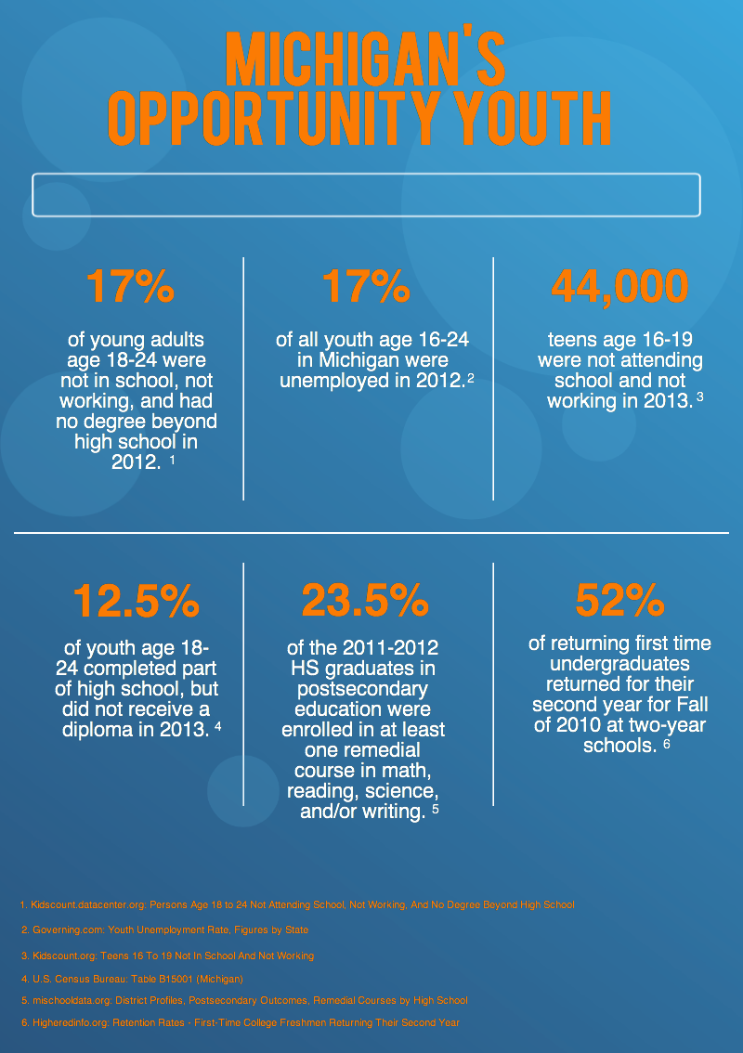
Notes:
17% of young adults age 18-24 were not in school, not working, and had no degree beyond high school in 2012.
17% of all youth age 16-24 in Michigan were unemployed in 2012.
44,000 teens age 16-19 were not attending school and not working in 2013.
12.5% of youth age 18-24 completed part of high school, but did not receive a diploma in 2013.
23.5% of the 2011-2012 high school graduates in postsecondary education were enrolled in at least one remedial course in math, reading, science, and/or writing.
52% of returning first time undergraduates returned for their second year for Fall of 2010 at two-year schools.

Slide 8
Michigan’s Opportunity Youth
17% of young adults age 18-24 were not in school, not working, and had no degree beyond high school in 2012.
17% of all youth age 16-24 in Michigan were unemployed in 2012.
44,000 teens age 16-19 were not attending school and not working in 2013.
12.5% of youth age 18-24 completed part of high school, but did not receive a diploma in 2013.
23.5% of the 2011-2012 high school graduates in postsecondary education were enrolled in at least one remedial course in math, reading, science, and/or writing.
52% of returning first time undergraduates returned for their second year for Fall of 2010 at two-year schools.

Slide 9
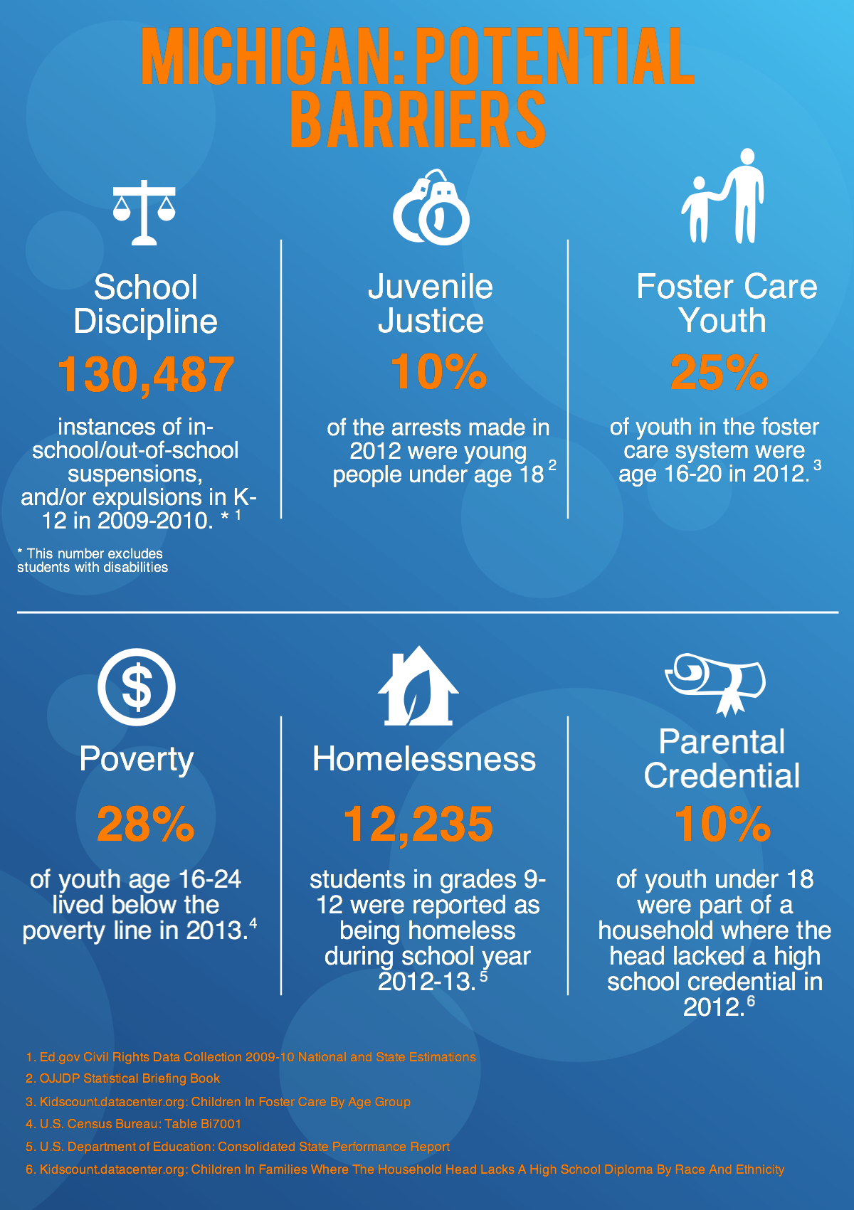
Notes:
There were 130,487 instances of in-school/out-of-school suspensions, and/or expulsions in K-12 in 2009-2010. (Excluding students with disabilities)
10% of the arrests made in 2012 were young people under age 18.
25% of youth in the foster care system were age 16-20 in 2012.
28% of youth age 16-24 lived below the poverty line in 2013.
12,235 students in grades 9-12 were reported as being homeless during school year 2012-2013.
10% of youth under 18 were part of a household where the head lacked a high school credential in 2012.

Slide 10
Michigan: Potential Barriers
There were 130,487 instances of in-school/out-of-school suspensions, and/or expulsions in K-12 in 2009-2010. (Excluding students with disabilities)
10% of the arrests made in 2012 were young people under age 18.
25% of youth in the foster care system were age 16-20 in 2012.
28% of youth age 16-24 lived below the poverty line in 2013.
12,235 students in grades 9-12 were reported as being homeless during school year 2012-2013.
10% of youth under 18 were part of a household where the head lacked a high school credential in 2012.

Slide 11
Pathways to Long-Term Success
Detours off of the pathway to long-term success do not have to be permanent for youth.
Consider the reasons they became disconnected in the first place.
Pathways that create access to education and workforce while providing supports to address other areas of need and an opportunity for a young person to shape their future are most successful.
However, we must acknowledge :
First that no system can do this work alone, and
Second, that many of these young people have been involved with other systems such as child welfare, justice, or social services, which also should be considered critical partners in building pathways.

Slide 12
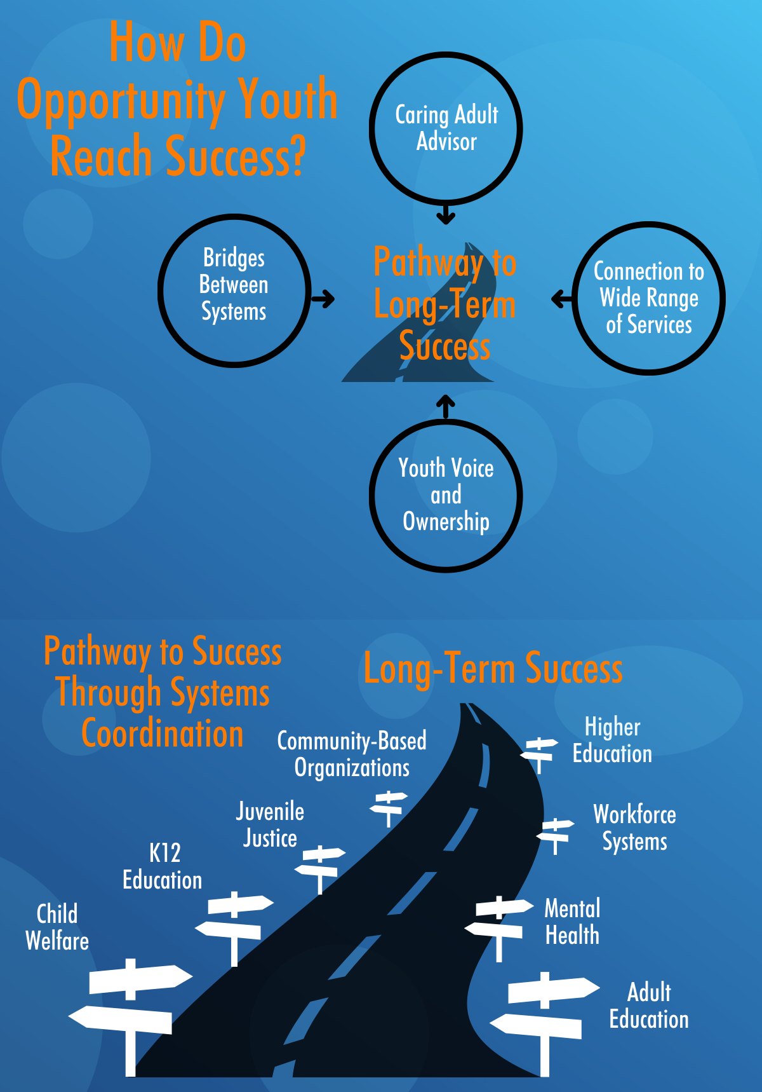

Slide 13
Common Elements of Practice Across All Pathways
A Caring Adult Advisor
Connections to a Wide Range of Services
Opportunities to Express Youth Voice and Ownership
Bridges Across Systems

Slide 14
Common Elements: Caring Adult Advisor
Adults who work with Opportunity Youth should…
Acknowledge and understand the role of past circumstances
Be equipped with appropriate training (i.e. trauma-informed)
Be knowledgeable about resources for future success
Michigan example: Mpowering My Success

Slide 15
Common Elements: Connections to a Wide Range of Services
Programs should not be siloed, but provide access to….
Education
Housing
Health services(physical, mental, social-emotional)
Transportation
Child care
Employment advising
Michigan example: Washtenaw Community College

Slide 16
Common Elements: Opportunities for Youth Voice & Ownership
Youth should have opportunities to…
Provide meaningful feedback about programming
Participate in collaborative conversations about programs and decisions
Serve as leaders within programs
Michigan example: Michigan Youth Opportunities Initiative

Slide 17
Common Elements: Bridges Across Systems
Services that address the needs of Opportunity Youth should…
Recognize the cross-system nature of needs
Blend delivery across systems, especially education and work.
Michigan example: Bridge Academy

Slide 18
Recommendation Highlights
Build consensus through use of similar language and desired outcomes
Frame the needs and solutions for the Opportunity Youth population in the context and language currently in use to build upon the momentum of related efforts.
Catalogue and understand the range of resources for Opportunity Youth in Michigan
Allows for greater collaboration across systems.
Using the resource mapping exercise, work to build a community of practice and shared understanding
Helps identify overlaps in services as well as the unfilled needs.

Slide 19
Organizational Support
Contact Jennifer at jlerner@aypf.org with your logo to add your organizational support

Slide 20
Moving Forward
Connecting the release and information to current initiatives:
Foster Care Agenda
School Justice Agenda
Family Literacy/Adult Education Agenda
Career Tech Agenda
College Access Agenda
Talent Development Agenda
Policy briefing partners
Current/needed Opportunity Youth coalition efforts to maintain momentum

Slide 21
Audience Q&A
To submit live questions, please use the “Questions” box
To share a resource with the entire audience, please send a chat to the entire audience

Slide 22
Contact Information
AYPF
Jennifer Brown Lerner
Deputy Director
jlerner@aypf.org
Erin Russ
Program Associate
eruss@aypf.org
Garet Fryar
Policy Research Assistant
gfryar@aypf.org
Michigan’s Children
Michele Corey
V.P. For Programs
michele@michiganschildren.org

