Slide 2
Where We’ve Been
2010 - 11
2011-12
2012-13
2013-14
Piloted evaluation components and process at 16 schools
Developed DPS definition of teacher effectiveness
Engaged principals and teachers in system design
Build organizational capacity through principal professional development and Teacher Leader Academies
First student survey
(SB 10-191 passed)
Piloted LEAP in 94% of DPS schools
Peer Observer team formed & performs additional teacher observations.
Refined system based on MET research findings
Aligned PD resources to Framework
Piloted Student Perception Surveys
LEAP at 100% schools
Revised Observation Framework from 21 to 12 Indicators
Teachers received indicator level results for all three Domains of the Framework (Instruction, Learning Environment, Professionalism)
Re-aligned PD resources to Framework and added Closer Looks
Professionalism scores received for first time
LEAP at 100% schools
All LEAP Observers calibrated & certified
Final LEAP rating given & reported to state using matrix
Revised Professionalism framework
Differentiated TL roles to support LEAP & support structures at 14 schools
Piloting SLOs at 15 schools
Piloting Specialized Service Provider Evaluation system
Work continues on differentiated PD.

Slide 3
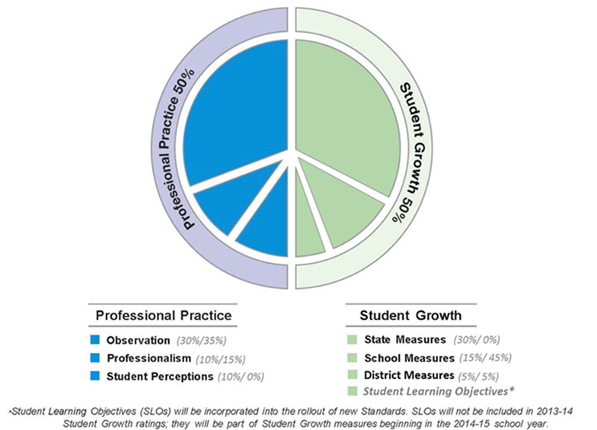
LEAP Components
Final scores for each side calculated based on formulas.
Matrix approach used to combine sides into a final rating.

Slide 4
MET Guiding Principles
MEASURE EFFECTIVE TEACHING
Set Expectations ✓
Use multiple measures ✓
ENSURE HIGH QUALITY DATA
Monitor validity ✓
Ensure reliability ✓
INVEST IN IMPROVEMENT
Make meaningful distinctions
Use data for decisions at all levels ✓
Balance weights ✓
Assure accuracy ✓
Prioritize support and feedback ✓
Developed The Framework for Effective Teaching as the basis of our shared definition of effective teaching
Multiple measures at balanced weights for each component of the system
More than one observer to increase reliability
Systems developed to ensure rosters are accurate and properly attributed to teachers
Observer training and certification process
Using multiple (three) years of data on student achievement gains
Master coded videos modeled after the MET Master Coding Boot Camp

Slide 5
Feedback Structures
DCTA on LEAP Steering Committee, Student Outcomes Working Group, SLO team and working groups, and SSP Evaluation pilot representation.
Two DCTA liaisons are part of the DPS project team
Our DCTA Teacher Outreach Manager visits schools to collect feedback and share information throughout the district in a variety of venue.
DCTA
LEAP Hotline & Website
Multiple Years of Design
Newsletters, Websites
DCTA Liaison and Outreach Managers
Focus Groups
Faculty Meetings
Teacher Leaders
5 Design Teams
42 school leaders and teachers on 5 design teams selected through an application process meet regularly to provide feedback and inform design.
The team responds to feedback and shares changes to system through newsletters and the LEAP website
23 separate focus groups launched the design phase.
We continue to hold focus groups across the district as needed to collect feedback.
Collaborative and iterative program design with changes based on feedback and data analysis through multiple years of design.
LEAP team members attend faculty meetings at schools across the district with Tom Boasberg (Superintendent) and Susana Cordova (CAO).
Faculty meetings are a two-way dialogue to talk with our educators, collect feedback on district priorities and answer questions.
Operations team responds to all feedback from the website, or via e-mail or hotline, within 24 hours
Teacher Leaders across the district meet monthly.

Slide 6
Implementation and Support
Alignment of Professional Learning resources to LEAP
Professional Learning aligned to Framework indicators, ongoing work to differentiate learning to teacher effectiveness levels (PD aligned to indicators)
School building leaders and teachers select indicators for focused Professional Learning at a building and individual level (Professional Growth Plans)
Structured observation feedback conversations with next steps for growth.
Partial and walkthrough observations allow for more frequent observations on targeted indicators.
Professionalism (offstage) is discussed in mid-year conversations with opportunity to grow and improve prior to final ratings at end of year.
Using LEAP data to inform entire teacher lifecycle
Use to evaluate pipelines, inform screenings and predict effective teachers
Inform new teacher induction, mentoring, professional learning
Support teachers to become effective through feedback and aligned support
Career lattices and teacher leadership
Identification of teachers for remediation plans

Slide 7
Student Perception Survey

Slide 8
Evolution of Student Perception at DPS
Spring 2011
Tripod survey piloted in 16 schools
2011-12
DPS-modified survey piloted in 127 schools
2012-2013
Survey expanded to include questions on rigor (9-29 Q’s)
All LEAP schools participated in grades 3-5 and 6-12 surveys
Survey for grades ECE-2 piloted (optional)
Feedback:
Too long (75+ questions)
Not specialized for ELLs, ECE, or Special Education
Shortened survey administered for 2,941 teachers (9-22 Q’s, based on grade level)
Modifications in survey and administration to support ECE, ELLs, and Special Education students
Spring 2012 survey administered for 1,713 teachers
Separate surveys for grades 3-5 and 6-12 with differentiated content
Survey administered in fall only
SPS scores used in LEAP ratings for first time (10%)
Fall administration window lengthened and spring makeup window added
2013-2014
ECE-2 survey eliminated . Grades 3-5 and 6-12 survey content combined to a single survey
61,277 survey responses results for 2,829 teachers
Prior to the makeup window had 79,000 survey responses and results for 2,877 teachers (final results available in April).
Reduced burden on students, teachers & staff
Increased flexibility for teachers and schools

Slide 9
2013-14 Revisions to Survey Administration
 | 2012-13 | Revised (2013-14) | Rationale
Survey administration window | Nov 13 – Nov 30 3 weeks | Oct 23 – Nov 22 (4 weeks) Makeup window: Feb 10 – Feb 28 (3 weeks) | Allows schools more flexibility in administering surveys for all teachers Accommodates variety of scheduling practices and circumstances
Days for schools to administer | 1-3 consecutive days within window | As many days as needed within window Days do not need to be consecutive
Classes surveyed | Elementary – homeroom Elem/Middle Specials – 1st class on administration days Secondary – 2nd period | Same, but: Specials and secondary teachers have option to administer survey to 1 additional class | Provides specials and secondary teacher with larger proportion of total students to survey (elementary teachers survey all students)
Proctoring | Teachers may administer to their own classes | Recommend that someone other than teacher administers: e.g., other teachers, administrators, paras, students (high schools) | Reduces inconsistencies in administration Avoids potential bias in student responses

Slide 10
Questions and Constructs
Survey items were revised with input from teacher focus groups, discussions with Teaching and Learning and DCTA.
Revising wording that may be difficult for students to interpret consistently (e.g., “concepts” changed to “ideas”)
Revising or removing items that are not applicable to all teaching contexts (e.g., questions specific to homework and writing notes on students’ work)
One list of items for all grade levels.
Our questions align to 3 constructs:
Facilitates Learning: Support and facilitation of student learning.
High Expectations of Students: Expectations for student behavior, including effort (includes both classroom management type items and high expectations for learning)
Supports Students: Teacher-student relationship focused on emotional and psychological support.

Slide 11
Scoring and Reporting of Results
Teachers and School Leaders access reports online within 6 weeks of administration.
Scoring based on % positive (Most of the Time or Always responses)
Grouped into quintiles for reporting as no LEAP ratings are given at the measure level.
Individual teacher data compared to District and School % positive
Data reported at school and teacher level, and disaggregated by:
Category and Question
Demographic data (ethnicity, gender, ELA, SPED)
Response distribution
At the end of the year scores are combined with other measures to give a teacher their summative LEAP rating.

Slide 12
Supports, Alignment, and Next Steps
Teachers discuss results with school leaders in mid-year conversations.
Results are a part of a holistic conversation that encompasses all LEAP data to date, including Observation and Professionalism.
Recommendations and guiding questions provided to school leaders, team leaders, and teachers in training materials (how to look at results in the context of other LEAP data).
Data analysis of alignment to other measures is ongoing.
Teachers who received additional Observation support though Differentiated Teacher Leaders saw a 1% average increase in scores over expected, the Teacher Leaders saw a 2% average increase.
Next steps for development:
Best practice recommendations and materials for involving students more deeply
Formal Professional Learning materials correlated directly to Student Perception Survey results

Slide 13
Survey Alignment with MET
MET Recommendations | DPS LEAP System
Measure what matters: Questions focus on what teachers do, and on the learning environment they create. | Revisions on questions based on results, extensive feedback, external review, and statistical analysis to ensure questions are relevant and appropriate.
Ensure accuracy: Student responses should be honest and based on clear understanding of questions. Confidentiality is a must. | Continued examination of administration protocols. Administration based on state testing protocols for confidentiality and recommend teacher does not administer.
Ensure reliability: Reliability requires adequate sampling and number of items so teachers have confidence that surveys can produce reasonably consistent results. | We found no statistical difference in 2 administrations a year and reduced to one administration and one make-up administration to reduce impact on instructional time. Added a second optional administration class period for teachers.
Support improvement: Teachers should receive results in a timely manner, understand what they mean, and have access to PD. | Teachers and school leaders have access to results online approximately a month after administration during mid-year conversations. We are still working on supports for improvement.
Source: Asking Students about Teaching: Student Perception Surveys and their Implementation (2012)

Slide 14
Engaging Students in the Educator Effectiveness Conversation: Building a Robust Student Perception Survey
May 1, 2014

Slide 15
OVERVIEW
Why use a Student Perception Survey?
What the Research Says
Survey Overview
Survey Development
Pilot Results
Survey Administration
Use of Survey Results
Building a Robust Student Perception Survey

