Slide 1
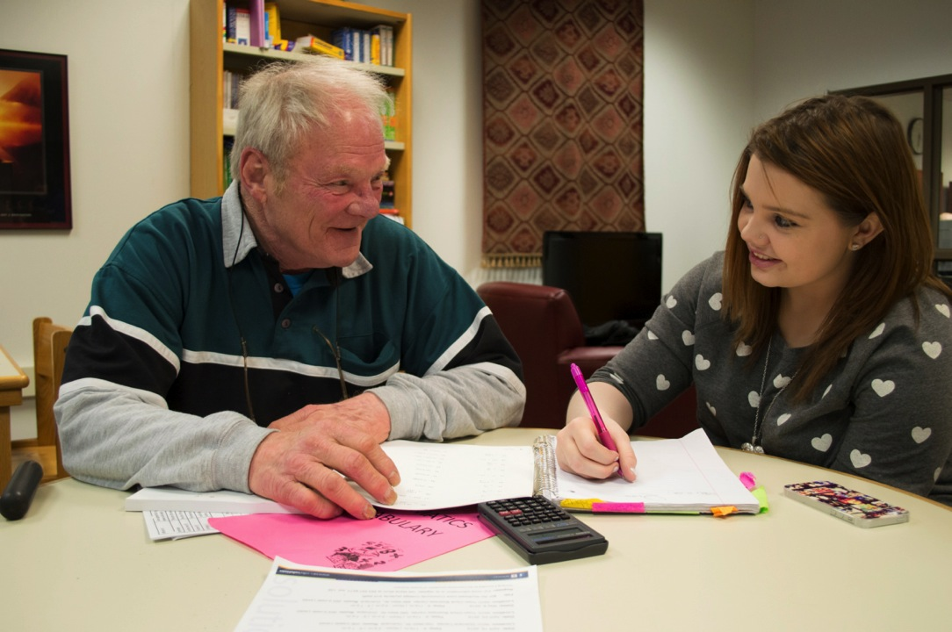
Re-engage Dubuque

Slide 2

Project HOPE
Community Foundation
City of Dubuque
Northeast Iowa Community College
Dubuque Community Schools
Eastern Iowa Intergovernmental Agency
Dubuque Works
Iowa Works
Circles Initiative

Slide 3
Dubuque Community School District
Student Drop-outs / District-wide
 | Male | Female | TOTAL
2007-2008 | 62 | 61 | 123
2008-2009 | 94 | 77 | 171
2009-2010 | 83 | 52 | 135
2010-2011 | 95 | 42 | 137
2011-2012 | 55 | 41 | 96
2012-2013 | 56 | 21 | 77
TOTALS | 334 | 232 | 566
average of 141 per year

Slide 4
Tax burden per student
$13,900
Immediate annual taxpayer burden, 2011 dollars
Study by labor economists called The Economic Value of Opportunity Youth

Slide 5
Missed earning potential
$7,000
Annually vs. worker with Diploma or GED, 2011 dollars
Study by labor economists called The Economic Value of Opportunity Youth

Slide 6
why?

Slide 7
Students Contacted
206
Since August 2012

Slide 8
Why they left

Slide 9
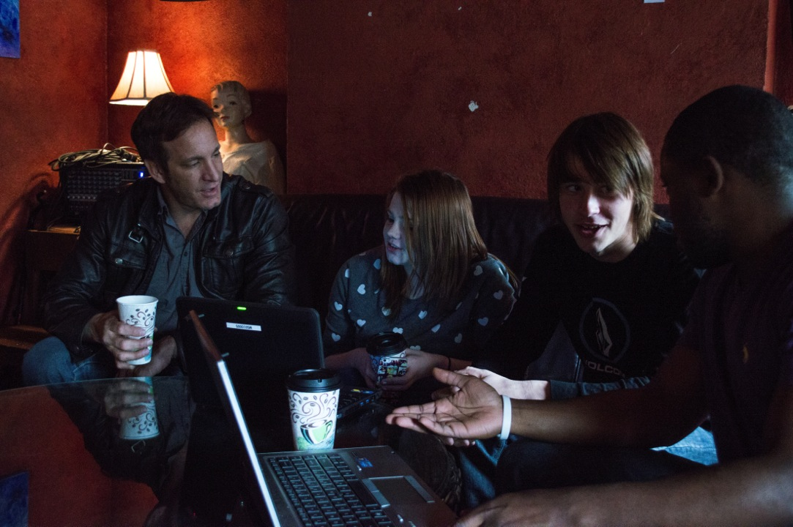

Slide 10
87% Re-engaged
180
Since August 2012

Slide 11
37% Completed Diploma or GED
66
Since August 2012

Slide 12
Average Days to Complete
97
Since August 2012

Slide 13
Dubuque Community School District
Student Drop-outs / District-wide
 | Male | Female | TOTAL
2007-2008 | 62 | 61 | 123
2008-2009 | 94 | 77 | 171
2009-2010 | 83 | 52 | 135
2010-2011 | 95 | 42 | 137
2011-2012 | 55 | 41 | 96
2012-2013 | 56 | 21 | 77
TOTALS | 445 | 294 | 739

Slide 14
Project HOPE
Community Foundation
City of Dubuque
Northeast Iowa Community College
Dubuque Community Schools
Eastern Iowa Intergovernmental Agency
Dubuque Works
Iowa Works
Circles Initiative

Slide 15
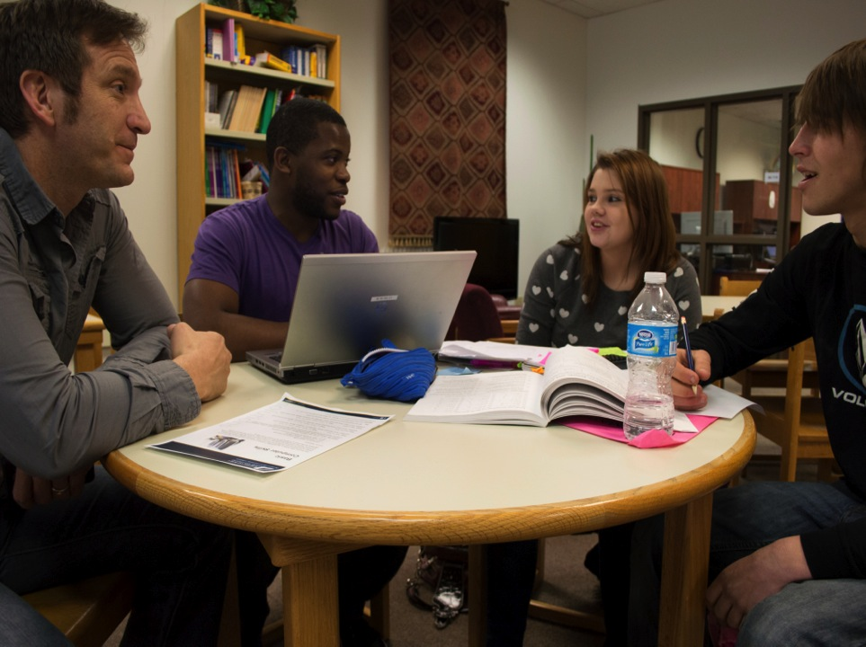

Slide 16
Re-engage Dubuque
YEAR 1 PROGRESS
Eric Dregne
Vice President of Strategic Initiatives
Community Foundation of Greater Dubuque
eric@dbqfoundation.org
www.dbqfoundation.org

Slide 17




Closing Remarks
Allie Kimmel, Office of Representative Jared Polis
@AYPF_Tweets
#aypfevents

Slide 18
Questions?
@AYPF_Tweets
#aypfevents

