Slide 1
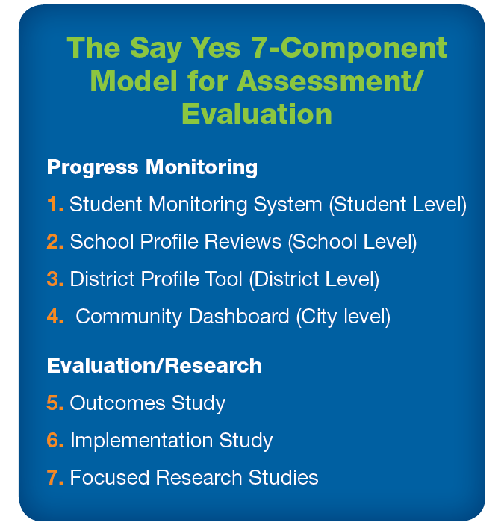

Slide 2
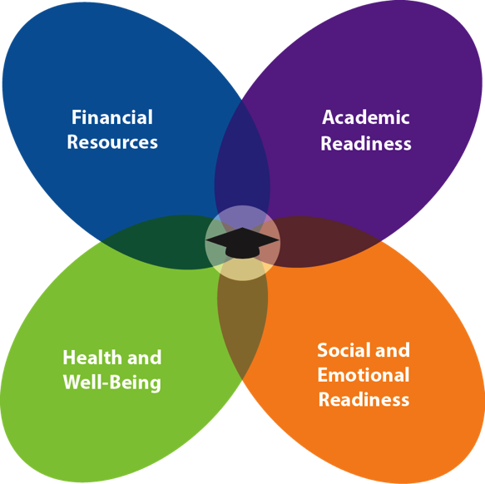
Factors That Say Yes Considers Crucial to Student Success
Notes:
Evidence for focusing on these 4 factors:
Academic Readiness: Low-income students less likely to be enrolled in stimulating and academically advanced classes taught by most skilled teachers, and have more limited access than to middle-income students to high-quality tutoring, engaging preschool, extra-curricular, afterschool, and summer education.
Social and Emotional Readiness: Low-income students are more likely than middle-income students to suffer from depression, anxiety, and social or emotional problems given the chronic stressors that they face and the lower likelihood for them and their families to receive support services due to lack of financial resources and/or information about access.
Health and Well-Being: Low-income students are more likely than middle-income students to have illnesses due to environmental stresses, but are less likely to receive support services.
Financial Resources: Low-income students and their families experience challenges affording postsecondary education because of limited financial resources
Authors of literature review: Kendziora, Osher, & Schmitt-Carey, 2007

Slide 3
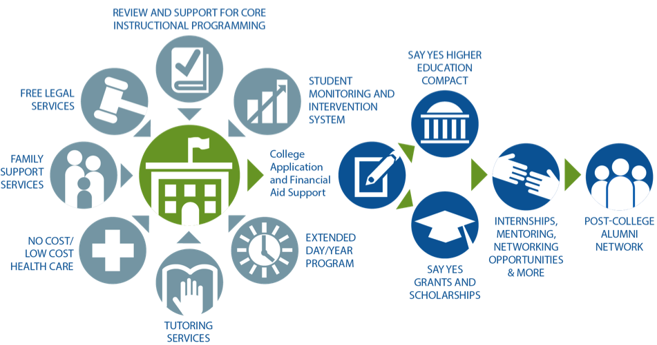
Say Yes’ Key Levers for Change: Comprehensive Student and Family Supports
Notes:
3
Student Monitoring
Extended Day/Year
Tutoring
No/Low Cost Health Care
Family Counseling Supports
Free Legal Services
Review and Support for Core Instructional Program – aligned to common core standards
College Application and Financial Support
A) Say Yes Higher Ed Compact B) Say Yes Grants and Scholarships (local endowment)
Internships
Post-College Alumni Network
*Link educational and economic development pipelines within a city!
*Build pipelines for productive citizenship vs. prison

Slide 4
Say Yes to Education Student Monitoring and Intervention System (SMIS)
New way of doing business -- we focus on supporting students’ academic achievement, social, emotional, and health outcomes
A research-based Student Monitoring and Intervention System developed by the American Institutes for Research, a key partner
Continually updated profile for each student on 13 key indicators in domains of academic, social, emotional, mental, and physical health
Based on SMIS growth plan, students and families can enroll in intervention(s) before students are on a low-achievement trajectory
Notes:
There is a paper/pencil version and an electronic version.
Teachers and students complete the electronic version in school. Students complete the survey during computer lab or electives.
The surveys are published in the 6 major languages of the BPS school district: Arabic, Burmese, Karen (Tibetan), Napoli, Spanish, Somali
Depending on the age of the student there are different version of surveys that they complete and that their families complete. K – 2 do not answer questions about their health (e.g., Does the way you feel keep you from doing your best in school; do you have problems sleeping?)

Slide 5
Say Yes to Education Student Monitoring and Intervention System (SMIS) Inputs
MONITORING AND INTERVENTION SYSTEM
*Research Based Indicators that track to post secondary readiness
*AIR developed algorithms
*Technology based interactive system
School District data
Attendance, grades, discipline, test scores
Parent surveys
Teachers surveys
Student surveys
Other Provider input

Slide 6
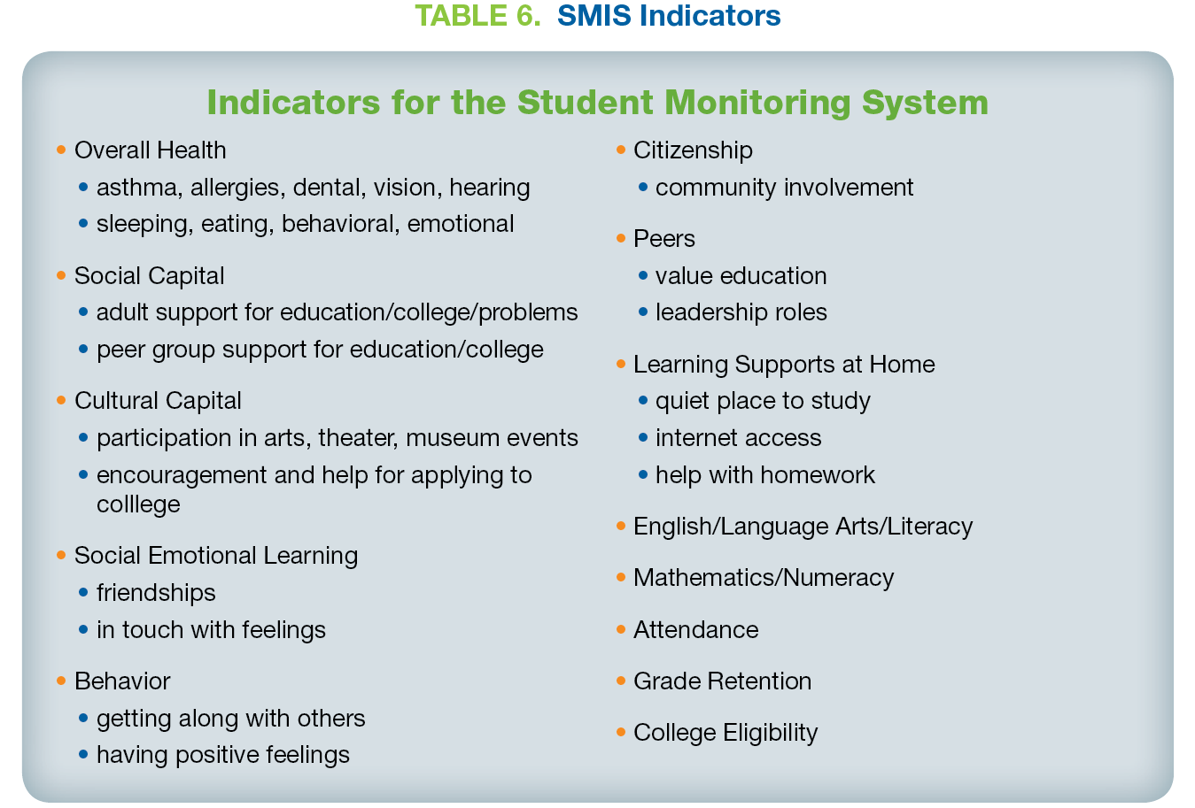

Slide 7
Say Yes to Education Student Monitoring and Intervention System Outputs
MONITORING AND INTERVENTION SYSTEM
*Research Based Indicators that track to post secondary readiness
*AIR developed algorithms
*Technology based interactive system
Individual Student Growth Plans including interventions
Reports on the overall effectiveness of the provider and of the specific interventions provided
Aggregate reports that support planning at the class, grade, school, district, and community level

Slide 8
Site Facilitators

Slide 9
Site Facilitator and Student Support Team (SST)
Say Yes Site Facilitators work in schools in a case management type role as part of the Student Support Team (e.g., psychologist, guidance counselor, social worker)
SSTs use Student Growth Plans to identify students who are off track and the appropriate intervention(s) for their needs
Using SMIS data it is possible to look at the relation between a student’s participation in an intervention, the dosage of the intervention, and their achievement outcomes
SSTs are provided with on-going professional development
Notes:
-Believe in and implement a community schools model
-Full-time staff embedded in schools to manage student monitoring and comprehensive intervention system within each public school
-Supported by city leadership team (Executive Director, Scholarship Director, Program Director/R&D, and Communications/Mobilization)
-Funded by County (68%) and City (32% Match)
-Federal and State policy largely ignores these key issues!
Professional Development for the Site Facilitators, SSTs, and Administrators:
Fall 2013 - Site facilitators and SSTs received professional development on implementing SMIS
Fall 2014 – A re-fresh training will be provided for site facilitators and SSTs
Fall 2014 – Intervention providers will be trained on data entry when
Principals have contact with and receive on-going support from site facilitators and Say Yes Buffalo Office staff

Slide 10
Demographics: Buffalo Public Schools
 | 2009-10 | 2010-11 | 2011-12
Enrollment PreK - 12 | 35,039 | 34,191 | 33,556
Free-Reduced Price Lunch | 77% | 79% | 77%
English Language Learners | 9% | 10% | 11%
American Indian | 1% | 1% | 1%
Black | 56% | 55% | 53%
Hispanic | 15% | 15% | 16%
Asian/Pacific Islander | 4% | 5% | 6%
White | 23% | 23% | 22%
Annual Attendance Rate | 86% | 86% | Pending release
Suspensions | 20% | 18% | Pending release
Source: New York State Education Department

Slide 11
High School Graduation and Dropout Rates, Buffalo Public Schools
Source: New York State Education Department
Notes:
Cohort graduation rates and they include August graduates

Slide 12
Regents and Regents Diploma with Advanced Designation, Buffalo Public Schools
All Students
Students of Color
Economically Disadvantaged Students
Source: New York State Education Department
Notes:
Since 2012, the majority of NY students are required to earn a Regents Diploma to graduate. The local diploma remains an option for students with disabilities and in special circumstances for non-SpEd students.
Students of color are designated as American Indian/Alaska Native, Asian/Pacific Islander, African American, Multiracial, and Latino/Hispanic.
Economically disadvantaged students are defined as students who participate in or whose families participate in:
Free- or Reduced-price Lunch Programs
Social Security Insurance (SSI);
Food Stamps;
Foster Care;
Refugee Assistance (cash or medical assistance);
Earned Income Tax Credit (EITC);
Home Energy Assistance Program (HEAP);
Safety Net Assistance (SNA);
Bureau of Indian Affairs (BIA);
Family Assistance: Temporary Assistance for Needy Families (TANF).

Slide 13
Lessons Learned and Next Steps
Response rate for family surveys
Students: 81.25%
Faculty: 96.35%
Families: 18%
Technology
3rd party IT vendor
Pulling data from multiple sources
Translating 6 languages for the electronic surveys
Timing of Survey Administration
Faculty’s knowledge of students
Building capacity for the SMIS to interface with postsecondary data bases
Establishing a shared understanding of the purpose of SMIS
Notes:
RESPONSE RATES:
Incentivize parents/families to complete the survey. Is there a monetary incentive?
Last year paper copies were available later than the electronic survey and some families missed filling out the survey because of that.
In the Fall 2014, paper copies of the survey will be more widely available.
Revised the survey questions based on focus groups. Focus groups consisted of school-based and administrative staff.
Revise the survey – the content remained the same, but some of the questions were asked in a more family-friendly way.
TECHNOLOGY:
The surveys are published in the 6 major languages of the BPS school district: Arabic, Burmese, Karen (Tibetan), Napoli, Spanish, Somali
Karen and Burmese use symbols that don’t show up on the web. Currently working with programmers to try to address this. The paper copies of the surveys are fine.
TIMING OF SURVEY ADMINISTRATION:
When is it appropriate to administer the survey? At the beginning of the year, teachers do not know students well, but the sooner the data are collected the sooner students in need can be identified for services.
SHARED UNDERSTANDING OF THE SMIS:
BPS approached us about using SMIS as part of their teacher and principal evaluation system. School Districts have requirements that they needs to meet and we have to work together to clearly articulate the indented purpose of early warning systems and maintain the integrity of these systems after they are implemented.

Slide 14
Early Results in Buffalo
Site facilitators have been placed in two-thirds of all schools, and the Student Management System has been launched
Summer bridge programs have been created in partnership with ECC and Medaille College
Community partners developed after school and summer programming framework; BPS committed to funding extended day for half of all schools beginning 2013-14
Securing commitment from Erie County to fund wellness clinics in every public school

Slide 15
Early Results in Buffalo
During the 2012-2013 Academic year, the first year for Say Yes in the district, Buffalo Public School officials noted two immediate trends.
There was a sharp increase in seniors’:
submitting college applications (an increase of about 40%) and
applying for financial aid (a 42% jump), when compared to previous years.
*Figures are based on estimates from Buffalo Public Schools

Slide 16
9 percentage-point increase from Fall 2012 to Fall 2013 in postsecondary matriculation rates immediately following high school graduation
Early Results in Buffalo: Postsecondary Matriculation
Source: National Student Clearinghouse
Notes:
There was a 9 percentage point increase in the matriculation rate from Fall 2012 to Fall 2013.
Mainly driven by an increase in 2-year matriculation rates (6 percentage points)
There was also an increase in 4-year matriculation rates (3 percentage points)
This is the first time in at least 7 years that the overall matriculation rate has been 66%.

Slide 17
Thank you!

Slide 18
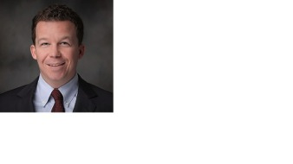
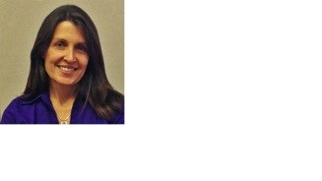
Questions?
Chris Kingsley, Associate Director, Local Policy and Advocacy, Data Quality Campaign
Laura Hansen, Director, Information Management and Decision Support, Nashville Public Schools
Gene Chasin, Chief Operating Officer, Say Yes to Education
Notes:
I would like to introduce our experts:
Nina Sonenberg is a Communications Officer at The Wallace Foundation. Nina has extensive experience in the nonprofit communications sector and joined Wallace to help sharpen

