Slide 1
Advocacy Coalitions and IOs in New Orleans
Groups in “education reformer” coalition include
Local and State Level: New Schools for New Orleans, Pelican Institute, teachNOLA, Louisiana Association for Public Charters, Educate Now!
National: Stand for Children, Black Alliance for Educational Options, Teach For America, The New Teacher Project, CEE Trust, Center on Reinventing Public Education
Groups in opposing coalition include
Local and State Level: Research on Reforms, New Orleans Education Equity Roundtable, Louisiana School Boards Association
National: Parents Across America

Slide 2
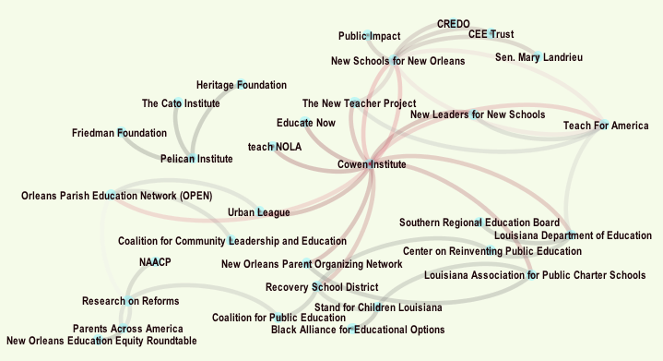
Preliminary map of coalitions
Notes:
Based on interview data—who key orgs named as their partners. Further research will include data for all named partners (snowball sampling)
Performance
Access and admissions to schools
Students with disabilities

Slide 3
Preliminary Findings (supply side)
Two opposing coalitions that interpret research results differently
Agreement that there is a lack of a credible, independent research voice
National level (NSNO report promoted by Sen. Mary Landrieu)
Some indication that the advent of vouchers in Louisiana may cause political divisions within local charter coalition
Notes:
On bullet one: Limited appeal to policy and advocacy folks, but non-ideological think tanks and research orgs still seem to value it, and the unions all read it. But university researchers seem to not have great reach.
On bullet three: some charter groups took no position on the voucher bill. In conversations, expressed concerns about lack of accountability and an already saturated market.

Slide 4
Preliminary Findings (demand side)
Opposing coalition organizations report BESE and state department not interested in their analyses
Cowen Institute at Tulane – relied on widely, but concern that mainly descriptive data
Many organizations and RSD report reliance on blogs, and contact with well-known researchers
Little use of peer-reviewed research (many not sure how to incorporate it)

Slide 5
Preliminary Findings, continued
With a couple of exceptions (New Schools for New Orleans and Louisiana Association of Public Charter Schools), relatively little research capacity in local IO networks
Culture of mutual mistrust
Implementation has not slowed despite research critiques; calls by Senator Landrieu for scaling up at national level
Opposing coalition, while not well-funded, has gotten some play in national media (e.g. Washington Post)

Slide 6
Culture of Mutual Mistrust
Well, I have no problem saying this, but I think that we are really plagued by the same two narratives. It's either everything is going great or things are going to hell. There's a middle ground. I do believe that we need to have a more honest conversation about the current state of affairs in New Orleans public education. What's missing is honesty. Meaning it just would really be helpful if the folks who were in the game didn't have a particular stake in the game, so that it would be more neutral. But everyone comes to the table as coming with an angle. Even us. We're not immune to that, but I think we really do try to be honest about what is happening, but oftentimes I think people are overly cautious or not cautious enough because of who they serve.
--Staff Member at Orleans Parish Education Network

Slide 7
Bibliometric and Twitter analysis
Measuring the impact/influence of reports on broader fields (and broader fields on a given report)
Considering the role of different approaches to research, and of IOs in advancing specific forms
Forward and backward mapping
Testing the “echo-chamber” hypothesis

Slide 8
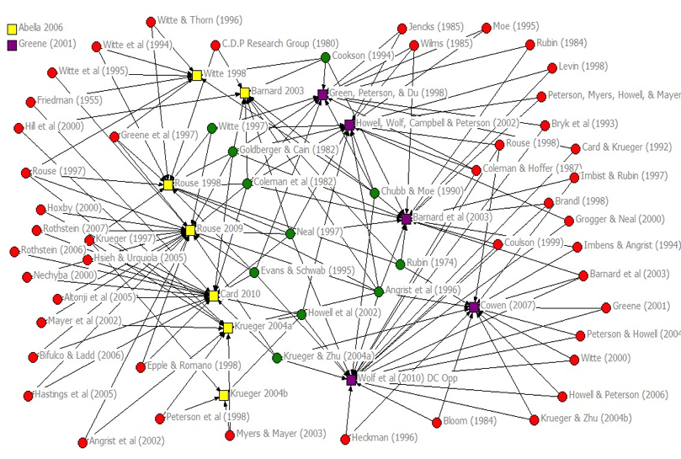
Citation Patterns (backwards) of two sets

Slide 9
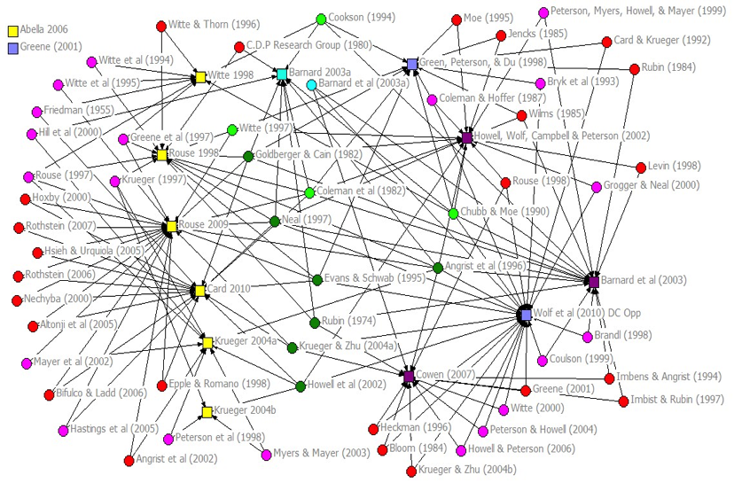
Map of Citation Networks with Peer Review Status (backwards)

Slide 10
Type of user mentioned by intermediary organizations tweeting about “charter schools”

Slide 12
Number of users mentioned by intermediary organizations and type of user mentioned in tweets about “charter schools”

