Slide 1
Audience Questions?
@CCRSCenter
@AYPF_Tweets
#AcceleratedEd

Slide 2
VERMONT FLEXIBLE PATHWAYS
February 2014

Slide 3
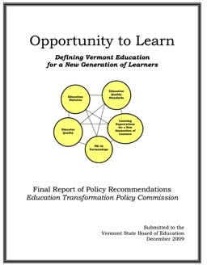
VT Transformation
SETTING THE STAGE FOR CHANGE

Slide 4
VT Transformation
Vermont Context -Declining Student Population -High Graduation Rates, Low Postsecondary Attendance -History of Innovation, Collaboration
New England Context -NE Secondary School Consortium
Theory of Action -Policy, Practice and Public Will
Notes:
1 policy, practice and public will, personalization of learning, high quality, sustainable…understand vs agree
2 nessc, LIS, NE goals of grad,, ccr, postsec without remediation, political will/cover
3 student pop, goals for postsec, state funding, history of supports (ess, full service, portfolio, formative assessments, federal policy)

Slide 5
Implementation Progression
Policy Implementation
Act 77 Flexible Pathways of 2013 -Personal Learning Plans -Dual Enrollment & Early College Programs
EQS (Education Quality Standards) -Proficiency Based Graduation Standards
Community Engagement and Messaging (under development)
Personal Learning Plan Workgroup completed January 2014 http://education.vermont.gov/plp-working-group/agency-resources

Slide 6
Community College of Vermont
Building Capacity To Support High Quality
Dual Enrollment Pathways

Slide 7
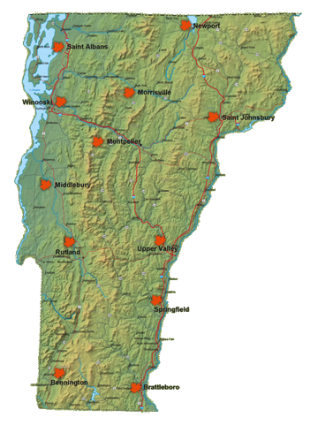
Community College of Vermont
Second largest college in the state
Only community college in the state
12 locations and online
7,000 students each semester

Slide 8
Why Dual Enrollment in VT?
Economic Development
By 2020 62% of VT jobs will require post-secondary training
Of the 25 fastest growing occupations, 19 require post-secondary training
In VT, associate degree holders earn 36% higher wage*
In VT, unemployment rate for associate degree holders are 2 points lower*
*Source: U.S. Chamber of Commerce

Slide 9
Why Dual Enrollment in VT?
Demographics
Increase college-going rate
Shrink the age gap
Improve college readiness
Reduce college debt
Shorten time to graduation

Slide 10
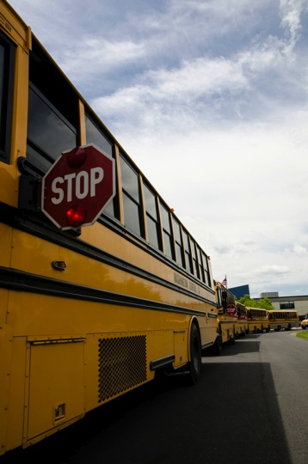
Challenges
Access
Quality and Rigor
Resources

Slide 11
Access Strategies
Collaboration with K-12
Relationships with individual schools and guidance counselors
Introduction to College Studies

Slide 12
Quality & Rigor Strategies
CCV manages all concurrent courses
Hire faculty
Offer professional development
Provide standard course objectives
Evaluate faculty and course outcomes

Slide 13
Resource Strategies
Build relationships with philanthropic partners
Seek out grants
Collaborate with community partners and organizations

Slide 14
In Closing
Relationships
Staffing
Quality & Rigor
Branding

Slide 15
Audience Questions?
@CCRSCenter
@AYPF_Tweets
#AcceleratedEd

Slide 16
Contact Today’s Presenters
Joe Harris, jharris@air.org
Jennifer Dounay Zinth, jdounay@ecs.org
Adam Lowe, alowe@nacep.org
John Fischer, john.fischer@state.vt.us
Joyce Judy, joyce.judy@ccv.edu
Jennifer Brown Lerner, jlerner@aypf.org
Recordings available at www.ccrscenter.org and www.aypf.org

