Slide 1
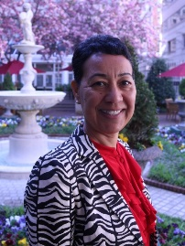
An Overview of Deeper Learning
Loretta Goodwin, Ph.D.
Senior Director, American Youth Policy Forum

Slide 2
Think of a powerful learning experience and what made it so?

Slide 3
Deeper Learning: Maine What is different about these personalized learning environments?
Notes:
This is 4 and half minutes

Slide 4
Deeper Learning: Wisconsin What particular skills do teachers need for these learning environments?

Slide 5
Deeper Learning: New Hampshire Who else should be included in the learning endeavor?

Slide 7
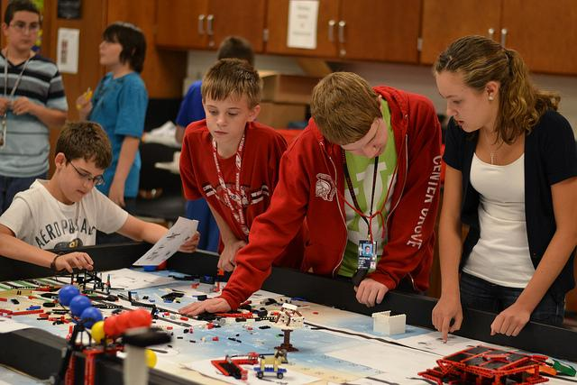
Master Core Academic Content
Interdisciplinary learning
Hands-on – field trips, internships
Project-based
Performance-based assessment

Slide 8
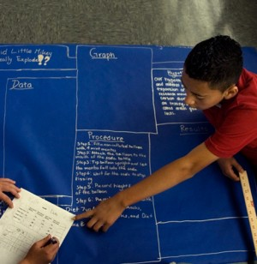
Think Critically and Solve Complex Problems
Use core content to develop arguments
Evaluate information
Think creatively
Solve novel problems
Reflect on process/quality of work

Slide 9
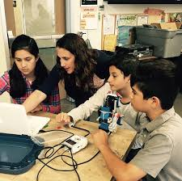
Work Collaboratively
Cooperate
Understand viewpoints of others
Be a good team member
Provide constructive feedback
Take on different roles

Slide 10
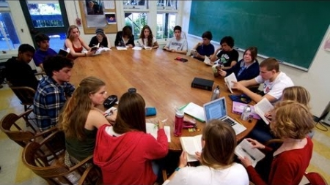
Communicate Effectively
Share knowledge, meaning and intention
Manage conflict
Listen actively
Present work
Student-led conferences
Draft and re-draft written work

Slide 11
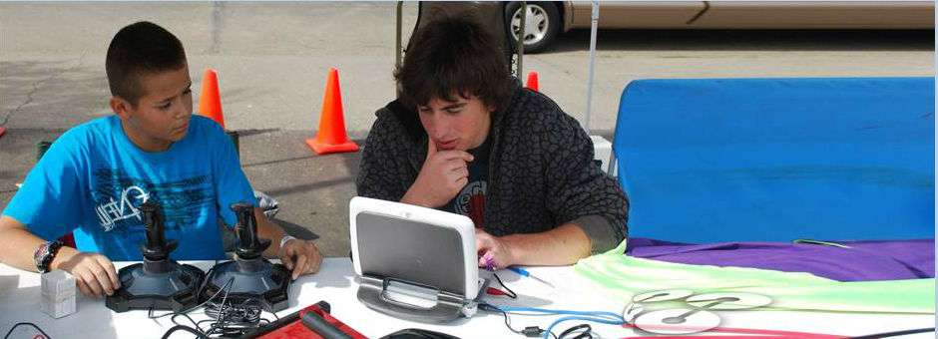
Learn how to learn
Take ownership
Understand learning style
Reflect on progress
Set goals

Slide 12
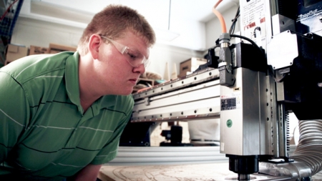
Have an ‘academic mindset’
Believe in your capabilities
Persevere
Learn from others
Find connections to real world

Slide 13
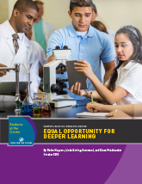
Mounting Evidence
Studies by:
Stanford Center for Opportunity Policy in Education (SCOPE)
American Institutes for Research (AIR)
Jobs for the Future (JFF)

Slide 14
A Different World
How is today’s world different from even 50 years ago?

Slide 15
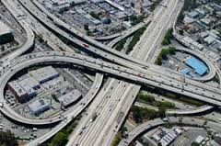
An Ever-Changing World
Explosion of complex technology
Climate change
Interconnected
Information overload
Greater inequality
Changing job market

Slide 16
Why Deeper Learning Now?

Slide 17
Additional Resources

Slide 18
Additional Resources

Slide 19
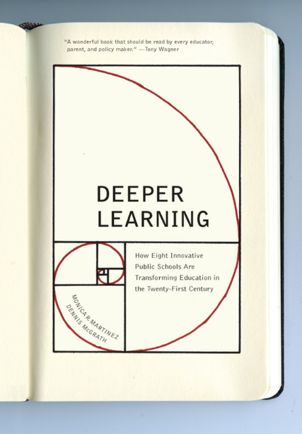
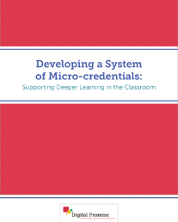
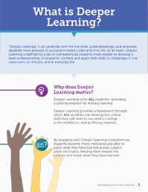
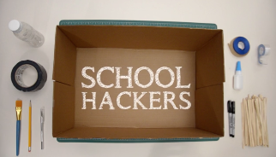
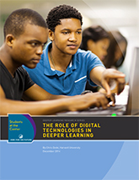
resources
FOR TEACHERS
Teaching Channel Videos
Monica Martinez Book
Digital Promise Micro-credentials
High Tech High Conference
School Hackers
https://www.teachingchannel.org/deeper-learning-video-series
http://www.amazon.com/Deeper-Learning-Innovative-Transforming-Twenty-First/dp/1595589597
http://www.digitalpromise.org/blog/entry/supporting-deeper-learning-in-the-classroom
http://www.deeper-learning.org/dl2015/
http://www.businessinnovationfactory.com/projects/student/portfolio/school-hackers
FOR ADMINISTRATORS
School Retool
EdLeader 21
Monica Martinez Practitioner’s Guide
AIR study
http://www.schoolretool.org/about
http://www.edleader21.com/
www.DLPlanningGuide.com
http://www.air.org/project/study-deeper-learning-opportunities-and-outcomes
FOR POLICYMAKERS
Education for Life and Work
Jobs for the Future Deeper Learning Series
National Commission on Teaching & America’s Future
Alliance for Excellent Education
CCSSO Innovation Lab Network
http://www.nap.edu/catalog/13398/education-for-life-and-work-developing-transferable-knowledge-and-skills
http://www.jff.org/initiatives/students-center/what-deeper-learning
http://nctaf.org
http://deeperlearning4all.org/
http://www.ccsso.org/What_We_Do/Innovation_Lab_Network.html

Slide 20
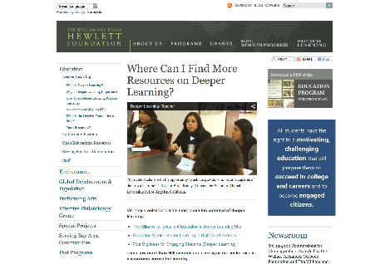
take action
VISIT A DEEPER LEARNING SCHOOL
http://www.hewlett.org/programs/education/deeper-learning/more-resources
TAKE A LOOK AT A DEEPER LEARNING RESOURCE
http://www.jff.org/initiatives/students-center/what-deeper-learning
BECOME A DEEPER LEARNING CHAMPION
COMMUNICATE
INQUIRE
TRY IT OUT !
#deeperlearning
http://www.edleader21.com/
http://www.schoolretool.org/big-ideas
http://blogs.edweek.org/edweek/learning_deeply/

