Slide 1
From Beating the Odds to Changing the Odds:
Seven Ideas on How to Bring Power to Your Passion for Improving Education
Karen Pittman, President and CEO
The Forum for Youth Investment
Samuel Halperin Lecture
Washington, D.C. | April 2017

Slide 2
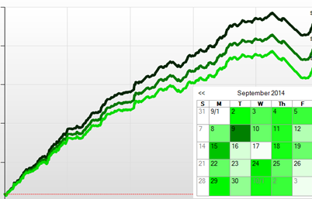
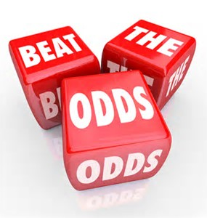

Beating the Odds vs. Changing the Odds
Notes:
Most of us are here because of a commitment to change the odds for those who get far too few of these experiences. Let’s talk about this phrase – change the odds…. I won’t say that I coined it, but I started using it 20 years ago to explain my discomfort with Children’s Defense Fund’s “Beat the Odds” annual awards… (I worked for CDF at the time). The individual young people being celebrated deserved to be celebrated. They had indeed beaten odds that were stacked against them at home, in school, in their neighborhoods, with their peers…. My concern was that that adults may have been celebrating young people’s success as theirs. We need to recognize young people who have MASTERED LIFE in spite of the huge odds against them. But we should celebrate our contribution only when we can point to collective successes we have had in changing the odds for large numbers of kids and families.
So let’s talk about the odds.

Slide 3
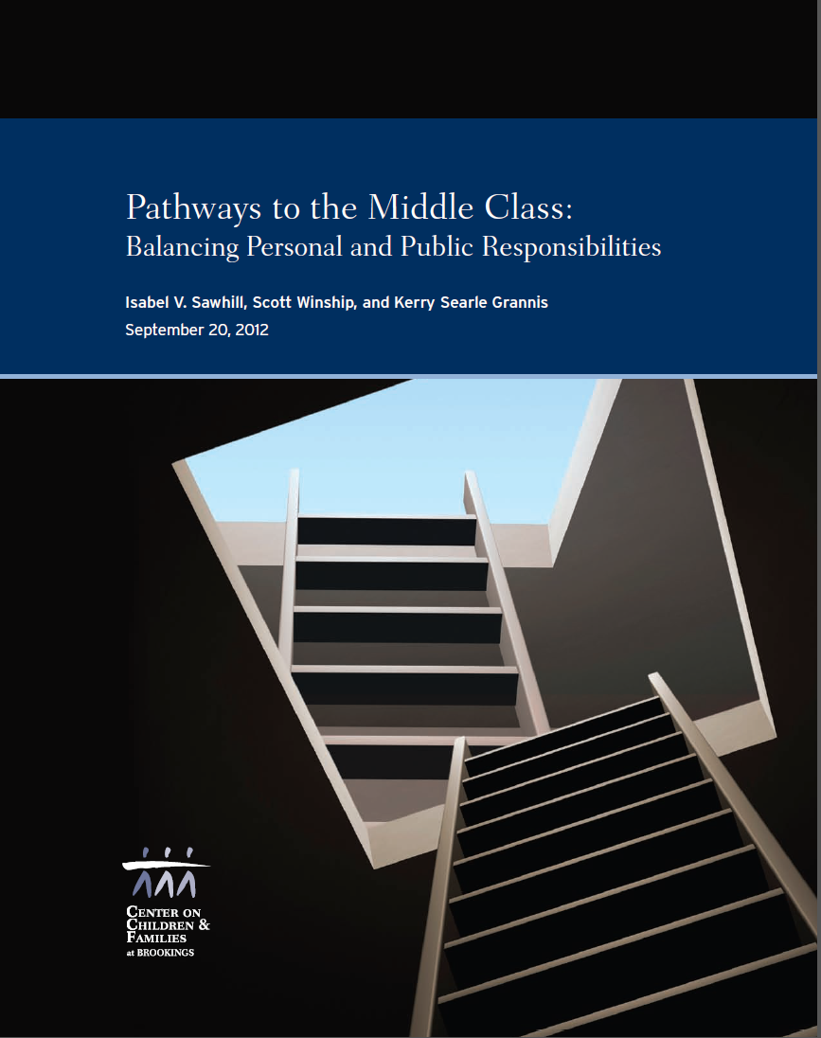
The Social Genome Project
Notes:
The Social Genome Project was created almost a decade ago by the Bookings Institute. It was a massive, multiyear effort to mine multiple data bases to build a simulation model that could track thousands of “ composite individuals” from birth (actually from conception) to middle age. The purpose of the project was to have the capacity to model the impact of current policies and potential changes (e.g. increased funding for Head Start). To prepare for these analyses, the team calculated the odds of being successful at every developmental stage and identified the primary predictors of success at that stage that could/should be the target of policy interventions. I had the privilege of sitting on the advisory committee. The by-products from this initiative are incredible. I encourage you to scan them. I’m going to talk about one. The Pathways study.
One flag: modeling has to have a target. The target for the Social Genome Project was middle class by middle age. Getting children who were born off track into middle class (defined as 300% above poverty) by age 25. We are currently working with clients and communities that have rejected this goal but used the analysis as a starting point. We encourage you to do the same…

Slide 4
Key Determinants of Being “on Track” (Brookings Social Genome Project)
Family Formation:
Marriage
Delayed parenthood,
Maternal education & employment
Normal birthweight babies
Early childhood:
Reading & math skills
Social behavior
Middle childhood:
Reading & math skills
Social-emotional skills
Adolescence:
High school grad w/ 2.5 GPA
No convictions
No children
Young Adults:
Live independently
Post secondary degree or above poverty income
Notes:
To prepare for these analyses, the Social Genome Project team calculated the odds of being successful at every developmental stage and identified the primary predictors of success at that stage that could/should be the target of policy interventions. I had the privilege of sitting on the advisory committee. The by-products from this initiative are incredible. I encourage you to scan them. I’m going to talk about one. The Pathways study.
One flag: modeling has to have a target. The target for the Social Genome Project was middle class by middle age. Getting children who were born off track into middle class (defined as 300% above poverty) by age 25. We are currently working with clients and communities that have rejected this goal but used the analysis as a starting point. We encourage you to do the same…

Slide 5
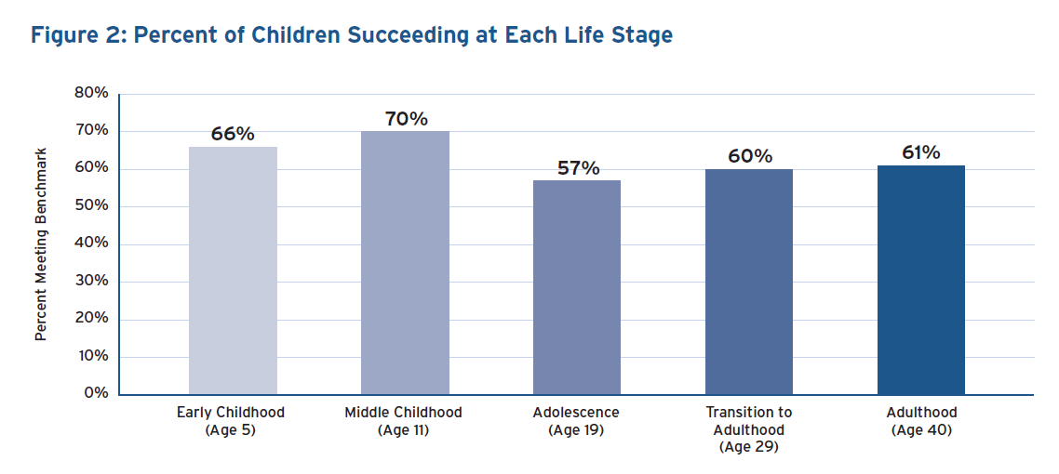
On Average 6 in 10 Children are “On Track” in Each Life Stage
Notes:
Let’s look first at the percentage of young people within every developmental stage who are “on track” for success in the next developmental stage. (With on track being defined as meeting the criteria just shown).
This is mostly a good news story if you’re satisfied that there is no developmental stage in which fewer than half of young people are ready for the next developmental hurdles. The average, across stages, is actually 62.8 percent, almost two thirds.

Slide 6
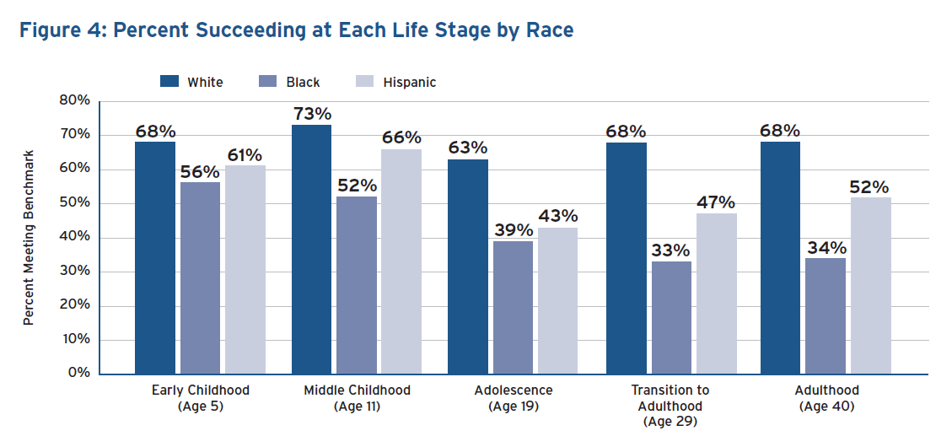
The Odds are Worse for Black and Brown Youth
Notes:
But it’s no surprise that this picture is not as rosy when broken down by race/ethnicity (the gender differences are comparatively minor).
White children and youth start with odds just slightly about the overall percentage (68% vs 66% in early childhood) and come close to maintaining this percentage across the developmental stages (the exception is adolescence).
African American children and youth start out with slightly worse odds that get progressively worse at each stage.
The odds for Latino children and youth are always significantly poorer than those for whites, but they vary more. This can, and should be a topic of conversation…. For a different talk.
This data is sobering. I want to make sure you see a part of the analysis that I interpret as extremely hopeful.

Slide 7
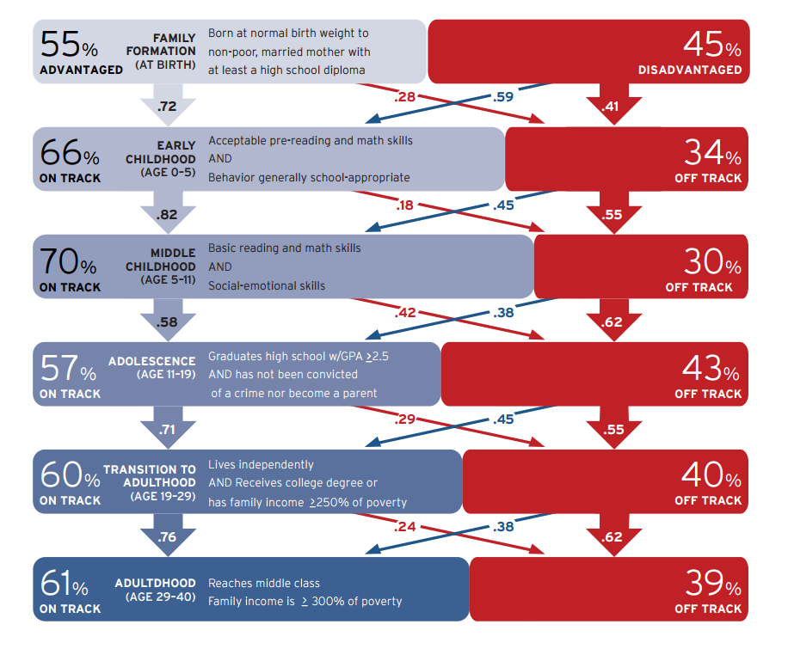
The Decisions We Make Can and Do Change the Odds
Key Determinants of Being “On Track” Family Formation: Marriage, Delayed parenthood, Maternal education & employment Normal birthweight babies
Early childhood: Reading & math skills Social behavior
Middle childhood: Reading & math skills Social-emotional skills
Adolescence: High school grad w/c+ No convictions No children
Young Adults: Live independently P.S. degree or above poverty income
s
s
s
s
s
Notes:
Let me build my favorite Social Genome slide for you. (I carry it with me most times). Remember the critical determinants of being on track for each developmental period. Let’s load the percentages that are “on track” or “off track” for each period. This is for all children and youth. Not disaggregated by race/ethnicity. The visual reminds us – the percentage on track is greater than the percentage off track in each developmental period.
the strongest predictor of being on track in one developmental period is being on track in the last one. Early investments count. (The arrows going from one row to the next show the likelihood of moving directly forward).
Note however, that the percentage of young people who are off track in one period who move on to be off track in the next is usually lower than the “smooth passage” percentages. The hurdles that are hardest to leap over to get “on track” for those “off track” are the key social transition from middle childhood to adolescence, and the last economic transition from young adulthood to middle-class adulthood.
What is most interesting to think about is the movement between on track and off track. It happens, at every stage, for a significant proportion of the age group. If there is a better argument for making EARLY AND SUSTAINED INVESTMENTS in children and youth (and young adults), I don’t know what it is.
At every stage there is a significant proportion of youth who – because of a public program, a mentor, a change in family circumstances, and, especially in later stages, a personal commitment to strive to address challenges and embrace opportunities – move out of the red. Our public policies tend to be focused here for good reason.
At every stage, however, there is a smaller but not insignificant percentage of the age group that goes off track. Let’s ponder about why. Again, it could be because of a change in family circumstances or peer groups, or shifts in services assumed available… But these are young people who, in general, can benefit the most from continued front end investments in quality, relationship-rich programming and supports.
We should, obviously, work diligently to ensure that the individual youth we connect with beat the odds. But we can, literally, change the odds for entire groups of young people by making sure the strategies we use in practice to get or keep kids on track are acknowledged and supported by systems and policies. How do we do this?

Slide 8

So What Do We “Really Want”?
…most elected officeholders spend enormous amounts of energy trying to learn what their constituents “really want,” and even more, what’s needed to “make things right in the world.” Therefore, clear expressions of organizational, community, or individual interests, needs and demands are inherently useful to policymakers.
Even if they eventually act to the contrary, knowing who wants what and why is helpful in mapping the political terrain and defining the degree of maneuverability (“wiggle room”) available to the policymaker.
p.13

Slide 9
What are We Up Against? Are We Our Own Worst Enemy?
Politician’s Views Of Educators –
In their Own Words
Educators are arrogant, and worse yet, sanctimonious.
Educators don’t communicate effectively.
Educators don’t understand the legitimacy and importance of the political process.
Educators mainly want more money.
Educators blow with the wind and are addicted to fads and quick cures.
Educators blame everybody else for children’s failure to learn.
pp 24-25

Slide 10
How do we convey what we want in ways that stick?
Talk about what really matters for child and youth readiness and success, not just for graduation.
Talk about what young people have and need, not just about the system – put youth at the center.
Talk about the education ecosystem, not just the education system -- include other stakeholders, not just as advocates but important partners.

Slide 11
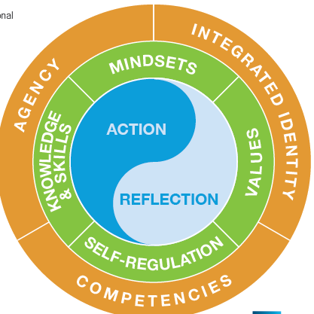
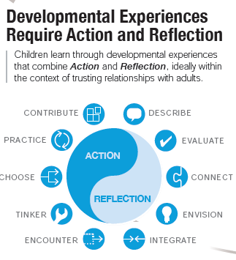
Readiness is more than a diploma
The 2002 NRC report, Community Programs that Promote Youth Development, identified 5 developmental domains that predict adult success:
The 2015 CCSR Report, Foundations for Young Adult Success, helps us understand how the skillsets and mindsets build an interconnect.
Physical development
good health habits, risk management skills
Intellectual development
school success, critical thinking, decision-making, life skills, vocational skills
Psychological and emotional development
good mental health, positive self-regard, self-regulation, coping skills, autonomy, effective time management
Social development
connectedness, sense of place, attachment to pro-social institutions, ability to navigate cultural contexts, commitment to civic engagement
Notes:
The 2015 report from the Chicago Consortium on School Research looks beyond the cacophony of language (grit, persistence, …) to provide us with an elegant statement of the determinants of the end goal: young adult success (outer circle), the critical components that youth build and combine to achieve competence, agency, identity (green circle) and the fundamental ways that youth build these skills – through action and reflection.
This new model is more integrated and elegant than the list provided by NRC in 2002 which outlined broad domains that predict young adult success… But you can see that the components are there..
The basic understanding that readiness is more than a diploma has been with us for a long time.

Slide 12
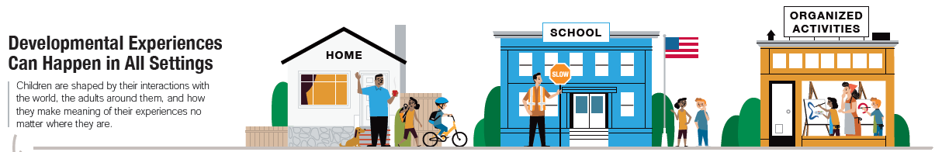

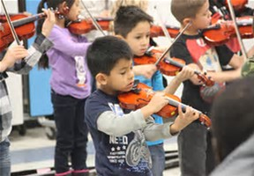
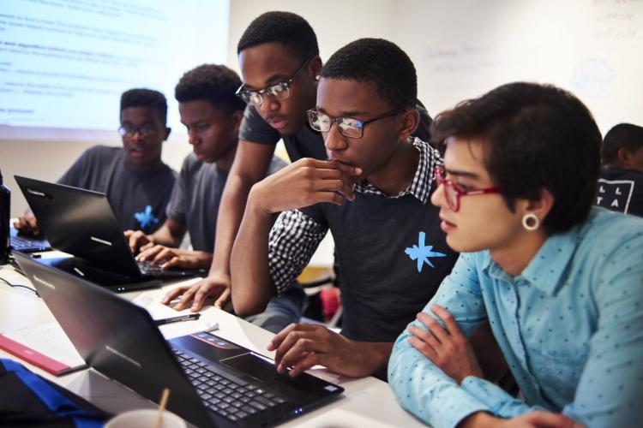
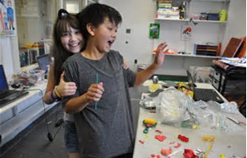
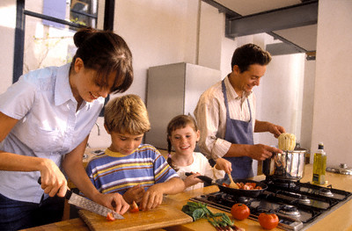
Readiness Requires Rich, Redundant Developmental Experiences
Notes:
We know a lot more than we did a decade ago about what it takes to create these experiences. And we know that school is not the only and, for many, may not be the primary please where they experience the kind of relevant, rigorous, relationship-rich environments we know are needed to foster youth success.
Family, community and in particular, organized activities within the community, are important developmental settings.

Slide 13
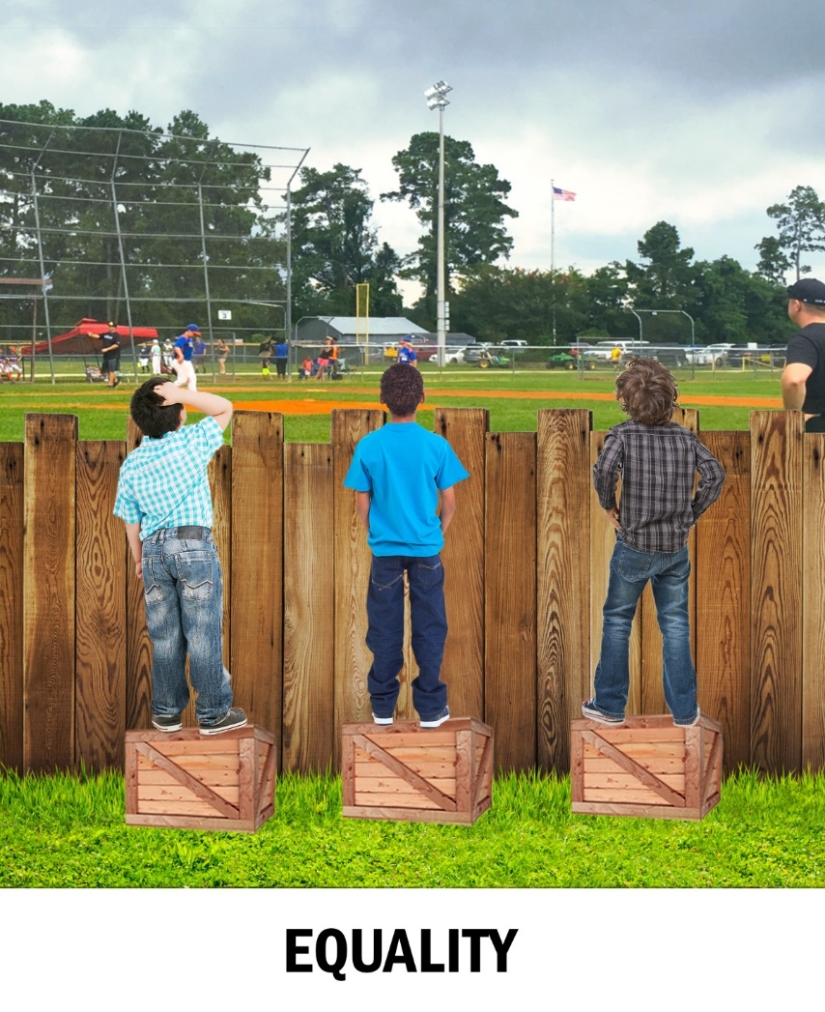
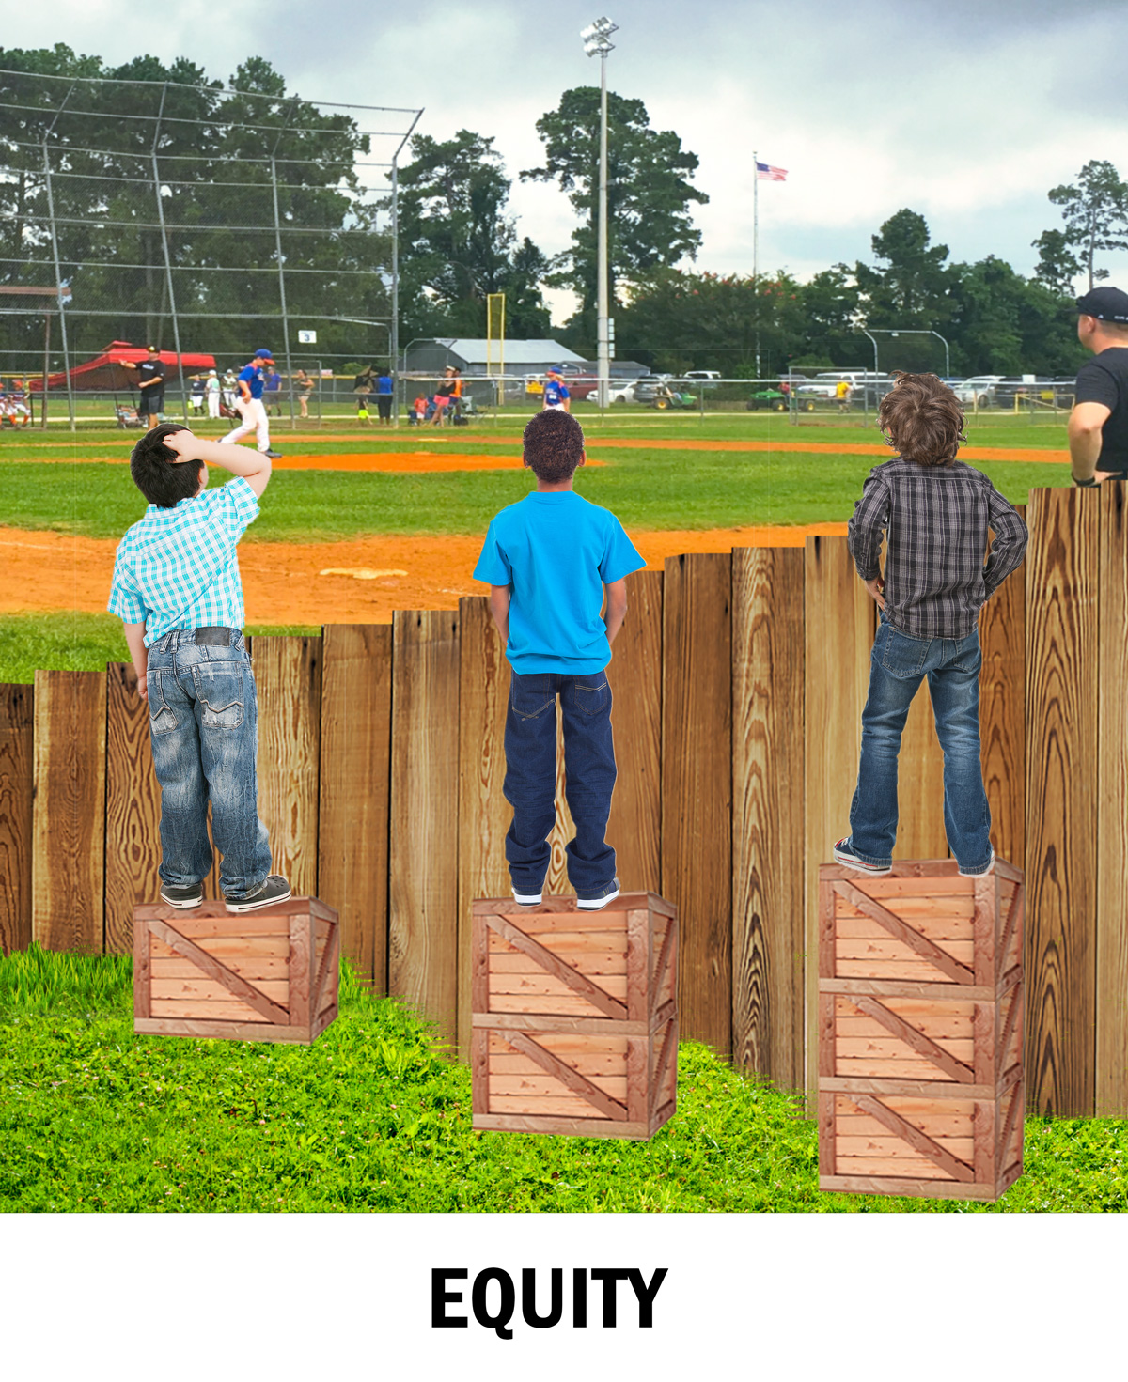
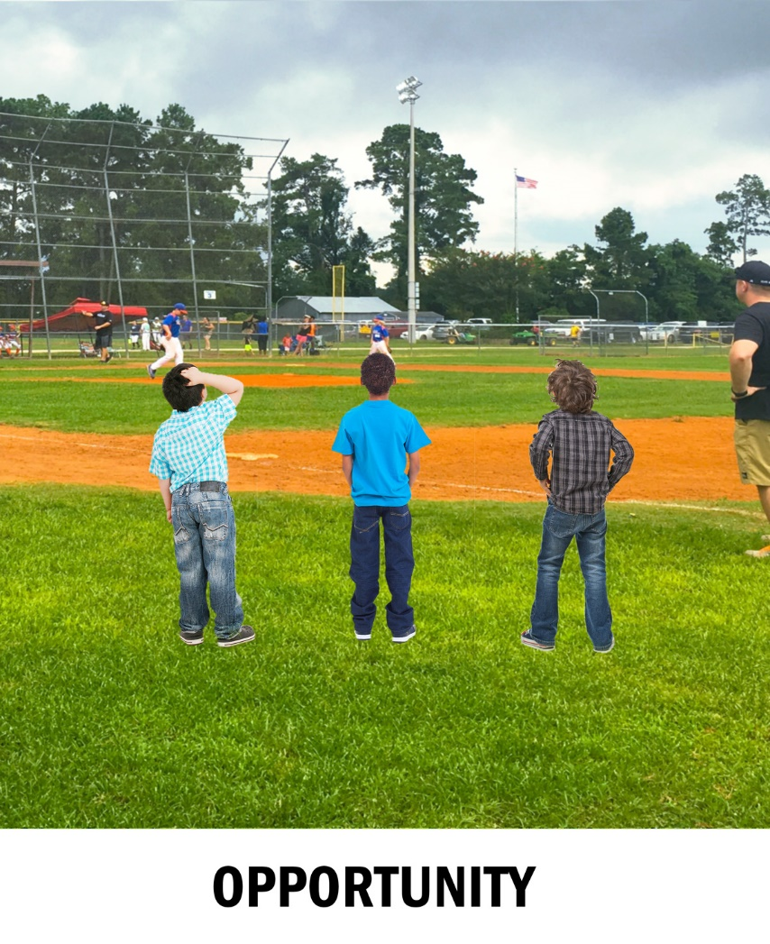
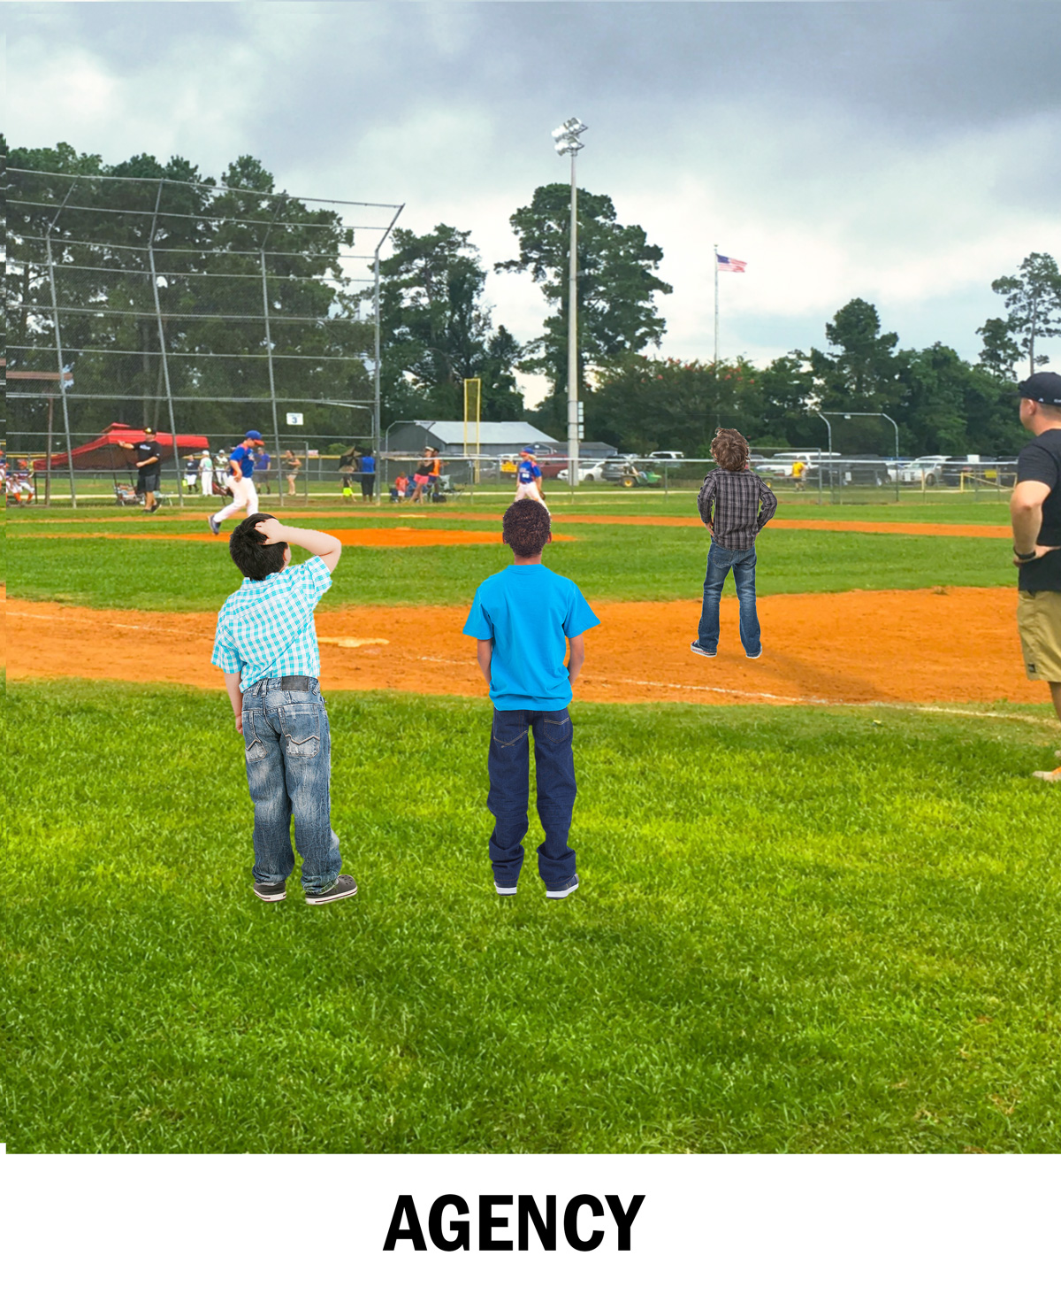
But we have to make sure we’re providing kids the opportunities they need to really be ready to play in the game
It’s important to acknowledge and reduce barriers to learning.
Is Reducing Barriers Enough?
Notes:
The goal isn’t just to get young people the resources they need to be able to see the future. It’s to reduce the barriers, so that they have the opportunity to participate – in AP courses, in afterschool and summer programs, in community service…
But our young people need to be more than willing – they need to be prepared.
We need to make sure that “opportunity” is being defined in a way that ensures that young people not only have access, but are ready to play in the game.
This is a critically important point. Quality matters.

Slide 14

Education Policy Doesn’t Always Speak Clearly to What We Know About Equity & Quality
RECOMMENDATIONS FOR TACKLING SYSTEM LEVEL POLICIES THAT HINDER EQUITY IN EDUCATION
1. Eliminate grade repetition
2. Avoid early tracking and defer student selection to upper secondary
3. Manage school choice to avoid segregation and increased inequities
4. Make funding strategies responsive to students’ and schools’ needs
5. Design equivalent upper secondary pathways to ensure completion
RECOMMENDATIONS FOR IMPROVING LOW PERFORMING DISADVANTAGED SCHOOLS
Strengthen and support school leadership
2. Stimulate a supportive school climate and environment for learning
3. Attract, support and retain high quality teachers
4. Ensure effective classroom learning strategies
5. Prioritize linking schools with parents and communities

Slide 15
Quality Matters…a Lot
Data from Summer Learning Programs
Notes:
This is data from the Summer Learning Initiative. The Weikart Center worked with the National Summer Learning Association to assess program quality.
Notice the huge jump in math improvement associated with high quality programs.
Know that the definition of quality is not “amount of time focused on math drills”…

Slide 16
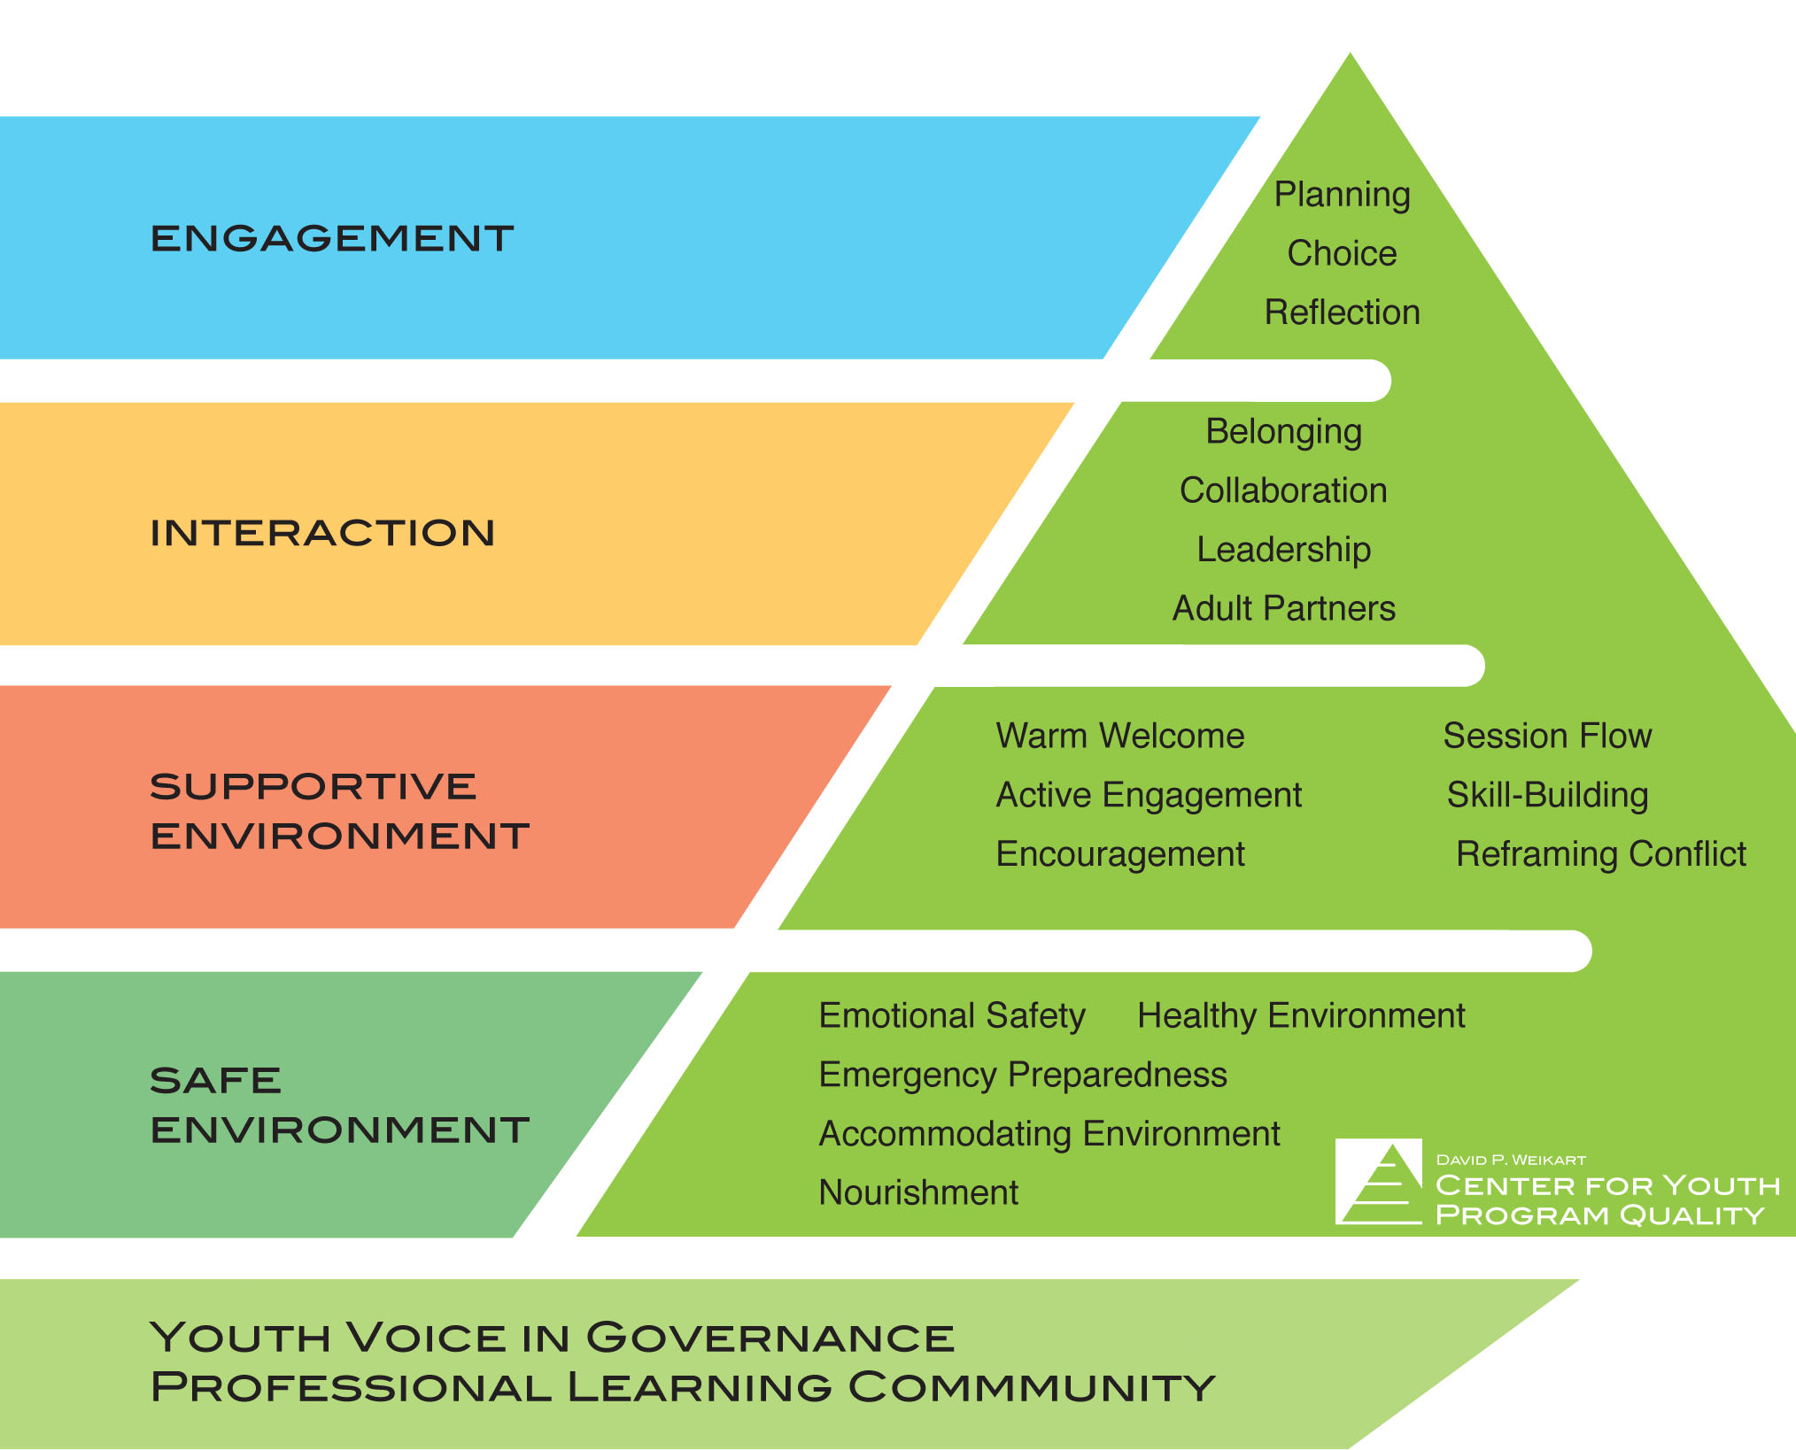
Quality Standards & Improvement Capacity: Prerequisites for Engagement
Notes:
Quality is defined as adherence to the basic standards associated with developmentally supportive settings – in school, in youth organizations, in families --- standards that were affirmed by the National Research Council in 2002, Community Programs to Promote Youth Development:
Physical and psychological safety
Appropriate structure
Supportive relationships
Opportunities to belong
Positive social norms
Support for efficacy and mattering
Opportunities for skill building
Integration of family, school and community efforts

Slide 17
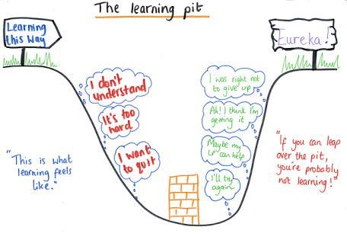
(source: http://www.supplyteachingsolutions.co.uk/#!Instilling-a-growth-mindset/c24tn/1)
Notes:
Here’s a visual that, for me, best explains why quality learning environments – environments in which adults, regardless of the content being conveyed, have a laser understanding of the importance of creating the context for engagement– have to be a part of the equity discussion.
The learning pit describes the natural process all of us go through when challenged to master something that’s hard for us. Whatever the content or focus of the challenge is, we use our social and emotional skills – emotion management, empathy, persistence/initiative, team work, responsibility, problem solving – to get over the wall.
Some children:
have had much more opportunity to build these skills and get recognized for them than others.
have used these skills to master learning tasks more successfully than others – they are predisposed to lean into the challenge.
have had more positive experiences with the specific “learning context” -- the setting (e.g. classroom), the people (peers and adults), the type of experience (academic, physical challenge)… than others.
Some adults:
Have a deeper understanding that students who are not used to succeeding in the learning context they have created (or not comfortable demonstrating their skills) may appear indifferent or even defiant
Have had more opportunity to work with students who have experienced trauma than others
Have had more experience naming, teaching, demonstrating, supporting and expecting these skills than others
Have higher expectations that all students (or particular subgroups of students) can “get over the wall” than others.
Have had more experience and success incorporating new ideas into their own practice than others.

Slide 18
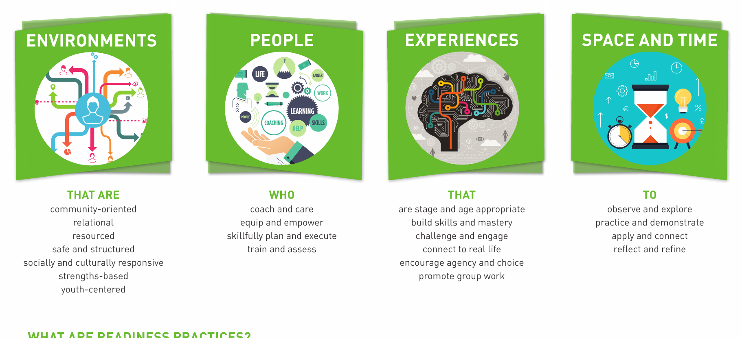
Readiness requires systematic efforts to ensure there is room within “official practice” to support developmental practice.
As educators you know this and have ideas about how policy-makers can help them strike the right balance. Share them. And have other stakeholders reinforce their importance.
Notes:
Whatever the learning goal we have for young people – art, algebra, athletics, avoidance of risky behaviors – we know that adults’ and systems’ chances of being effective increase when there is as much focus on the context as the content. This is true of all settings, including child welfare, juvenile justice and employment training.

Slide 19
Readiness responsibility goes beyond schools, but it has to be a priority of schools

Slide 20
How do we convey what we want in ways that stick?
Talk about what young people have and need, not just about the system – put youth at the center.
Talk about what really matters for child and youth readiness and success, not just for graduation.
Talk about the education ecosystem, not just the education system -- include other stakeholders, not just as advocates but important partners. Don’t oversell, but connect your issues to public opinion, the popular media, and concerns about bigger issues, e.g. the economy.
Talk about the issues facing young people and their families in their language so that you can respectfully convey the commonalities and the differences the students and families bring into schools and teachers experience in schools.
Let young people and families do the talking whenever possible, empowered with stories and facts.

Slide 21
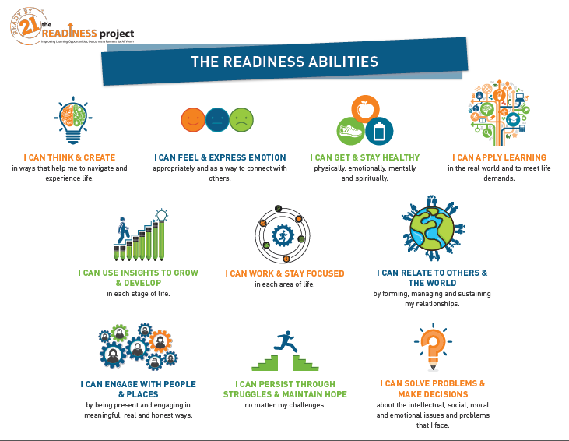

Slide 22
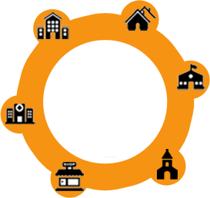

Build Competencies, Identity and Agency
Education Systems
Child Welfare & Juv. Justice Systems
Workforce Development Systems
Health & Prevention Services
Name Common Skills Needed to meet the goals set by each
Civic & Community Organizations
The Abilities Backpack

Slide 23
Shine a Light on the Traps in more traditional “development”systems
Age as Proxy for Stage When young people are assigned to a program, group or class based on age, rather than stage of learning, development or behavior..
Completion as Proxy for Competence When young people are allowed to move on to the next stage, grade, system or setting because they have finished—even if they are not ready. Or, when young people are ready to move on, but are not allowed because of certain policies or requirements.
Time as Proxy for Progress When young people’s time in a system or setting triggers when they move ahead, or when time is used as a way to measure a young person’s growth and development.
Access as Proxy for Quality When young people’s place of residence determines their access to quality schooling, services and programs..

Slide 24
How do we convey what we want in ways that stick?
Talk about what young people have and need, not just about the system – put youth at the center.
Talk about what really matters for child and youth readiness and success, not just for graduation.
Talk about the education ecosystem, not just the education system -- include other stakeholders, not just as advocates but important partners. Don’t oversell, but connect your issues to public opinion, the popular media, and concerns about bigger issues, e.g. the economy.
Talk about the issues facing young people and their families in their language so that you can respectfully convey the commonalities and the differences the students and families bring into schools and teachers experience in schools.
Let young people and families do the talking whenever possible, empowered with stories and facts.
Be prepared to act in ways that make the issues, the stakeholders, especially the young people, and the decision-makers more visible.
Be prepared for the long-game, we’ve been here before…

Slide 25

Use the Guide!! (pp. 35 – 38)
7) Acknowledge the arguments of the other side of a controversial issue. As a citizen petitioning your policymaker for “redress of grievance,” you want help from an informed and effective legislator, one who knows what liabilities may result from his/her help. Unless policymakers know all the countervailing risks and pitfalls they may well come to resent you or the issues you need help with, or both.
8) Before leaving, summarize the major points of your discussion and agree on followup actions by stated dates. Try to “clinch the sale” with specific commitments on your part and that of the lawmaker. “Giving your word and keeping it is the bedrock foundation of American politics,” says no less an authority than former Speaker of the House of Representatives “Tip” O’Neill. So try to elicit a promise as specific as possible.
9) Use the occasion to give the policymaker something of political value, such as an invitation to address a large gathering, to write his/her views on the subject
for publication in your organizational journal, an award or similar tokenrecognition.
10) When you return home, follow up, preferably in writing
Reaffirm the areas of agreement reached and summarize any plan or commitments for future action.
Most especially, thank the lawmaker (and, separately, the staff) for their time and concern. Legislators,
like all public officials, complain that they catch hell for almost everything and hardly ever hear a word
of praise or thanks.

Slide 26
“We must be the change we wish to see in the world.” -Mohandas K. (Mahatma) Gandhi

Slide 27
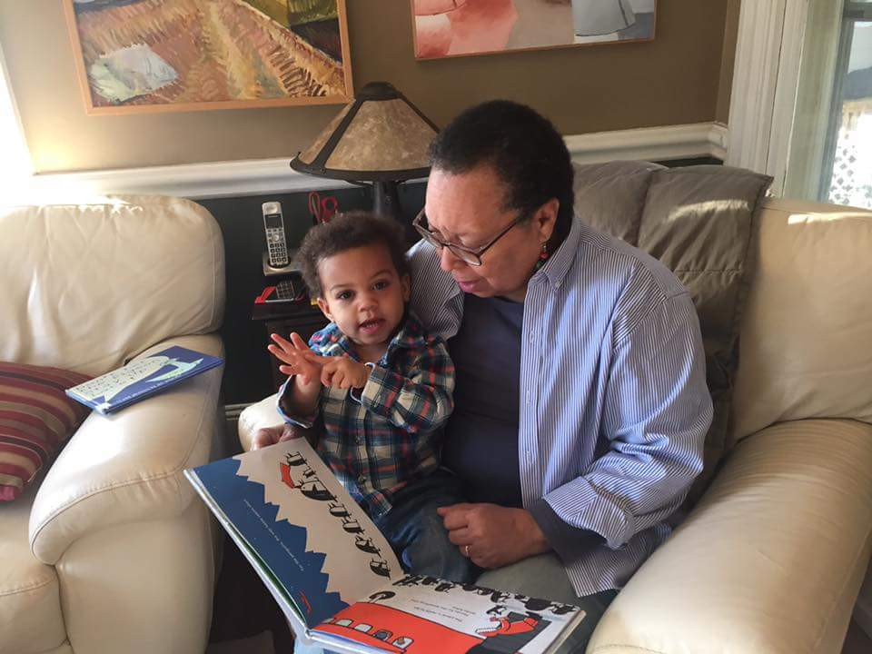
A Personal Reflection

Slide 28
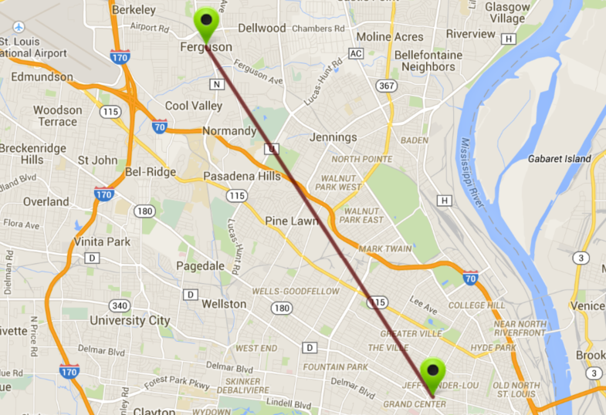
Distance Between Ferguson and St. Louis Central West End: Much More than Miles
Equality ►Equity
Readiness

Slide 29

Rise to the Challenge:
From Where and When
To Why, What and How

