Slide 1
Using Student Surveys: Implications for State and District Policy
May 1, 2014
@AYPF_Tweets
#aypfevents

Slide 2
The CCSR 5 Essentials Survey Helping Schools Organize for Improvement
Elaine Allensworth
The University of Chicago Consortium on Chicago School Research

Slide 3
Chicago 5 Essentials Surveys
Demonstrate that student and teacher reports have an empirical relationship to school improvement
Provide an evidence about how policies and initiatives affect students’ and teachers experiences in schools
Give actionable information that schools can use to prioritize initiatives and drive improvement

Slide 4
Chicago 5 Essentials Surveys
Administered to teachers in all grades and students in grades 6-12
Response rates of about 80% in 2013
Yearly administration since 2011, biennial from1997
Framework developed in 1994
Developed jointly by researchers, teachers, principals, members of reform organizations
Grounded in research and school practice
Notes:
The collaboration over many years built buy-in, familiarity.

Slide 5
Each Essential Represents Multiple Measures
Questions
Measures
Course Clarity
5 Essentials
I learn a lot from feedback on my work.
It's clear to me what I need to do to get a good grade.
The work we do in class is good preparation for the test.
The homework assignments help me to learn the course material.
I know what my teacher wants me to learn in this class.
Course Clarity
Math Pedagogy
English Pedagogy
Student Discussion
Classroom Behavior
Challenge

Slide 6
Surveys used for both research and school practice
Diagnostic tool for school improvement
Individual school reports provided confidentially to school leaders since 1997
In 2008, CPS adopted the “Five Fundamentals” for school improvement planning, based on survey tool
In 2009, reports became publicly-available
In 2013, survey results included in school accountability
Research tool
Allows researchers to understand how policies worked – effects on instruction, learning climate, support for student learning
Provides insight into key processes in schools – what matters most
Notes:
Examples of research on policies –ending social promotion

Slide 7
Surveys validated and refined through two decades of research
Initial study 1990-1996
Replicated from 1997-2005
Measurement of each component refined over time
Identify key construct from theory or practice
Develop measures – refine with each survey administration
Use in research – discover how it matters for schools or student outcomes
Refine theory
Track progress in schools

Slide 8
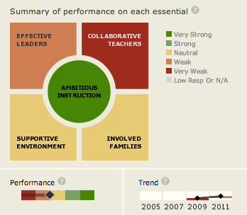
Reports to schools: 5 Essentials
https://cps.5-essentials.org/2013/
Notes:
Switched to color scheme based on results.
Need context to make meaningful
Color makes it easy to read, but becomes evaluative
What should be considered “strong”?
Same for all schools?

Slide 9
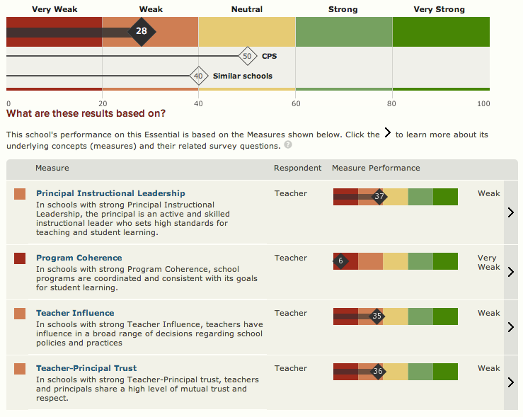
Reports to schools: Effective leaders example
Notes:
Comparison on each essential and each measure to similar schools. This is school leadership

Slide 10
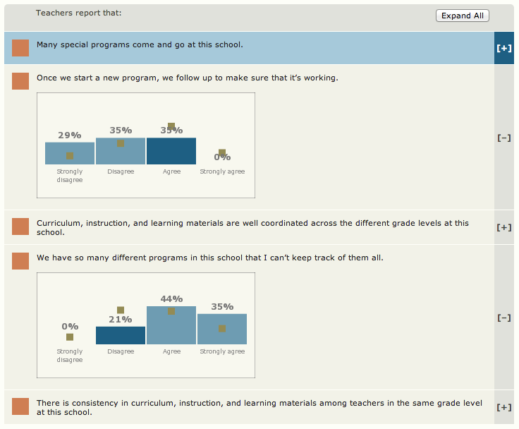
Reports to schools: Program coherence example
Notes:
Breakdown of responses of teachers/students on each question – these are two questions in program coherence.

Slide 11
Expansion of 5 Essentials Surveys
Now given in multiple cities by Uchicago Impact
Adopted by State of Illinois in 2012-13 school year
Mandated by law
Five Essentials Day
High participation in first year
Stakeholder meetings in first year – not enough at local level
Pushback once results were given to schools
Need for validation across settings, adapting to different contexts
Notes:
High participation: 93% of districts, 85% of schools, 75% of all teachers, 71% of all students
Pushback: Content, Comparisons
Without research showing it matters in their context, why should they take the survey? How can there be research without data?

Slide 12
Issues in design, implementation
Trade-offs from survey length, report length
Trade-offs from making results public vs confidential
Framework - useful or confusing
Comparisons to other schools – context with challenges
Content stability vs adaptability over time and across places
Notes:
Length: Longer more comprehensive, but more confusing – which measures to include in survey, and in reports? Too long - bad measurement from survey fatigue. Structure is debatable – which specific measures to include.
Public: Concerns about reporting bias, but more useful, more fair to respondents, more buy-in from multiple parties (all but principals)
Framework useful as a guide, consistent w/district guidance. But other places may have other frameworks in place.
Comparisons: Turns reports from formative assessment tool to evaluation of school, dispute over what comparison should be – what types of schools, what years?

Slide 13
Chicago 5 Essentials Surveys

Slide 14
Denver Public Schools LEAP: Leading Effective Academic Practice
American Youth Policy Forum: 5/1/2014

Slide 15
Denver Public Schools: Quick Facts
Schools (2013-14): 185
ECE: 3
Elementary: 85
K-8 Schools: 18
K-12 Schools: 4
Middle: 26
Grades 6-12: 14
High Schools (traditional): 35
Teachers (2012-13): 5,245
Graduation Rate (2011-12):
Official District: 58.8%
Dropout Rate (2011-2012):
5.7% (grades 7-12)
Students: 84,424 (As of October 1, 2012)
Hispanic: 58%
White: 20%
African American: 15%
Asian: 3%
Other: 3%
American Indian 1%
Free & Reduced Meals: 72%
English language learners (ELL): 35%
Gifted and Talented: 12.8%
Top languages spoken by students: Spanish, Vietnamese, Arabic, Somali, Amharic, Nepali, and Russian

